Slide 1
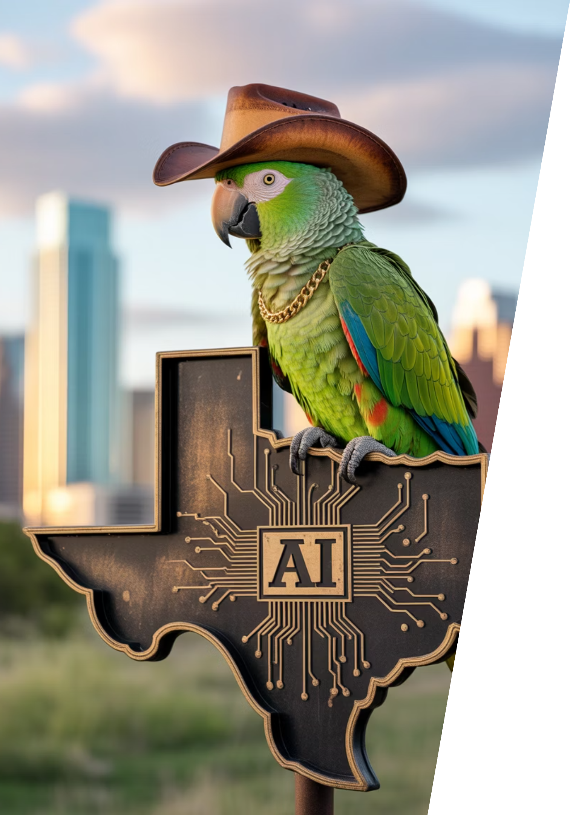
Austin LangChain AIMUG
Welcome to the Austin LangChain AIMUG - where Texas innovation meets AI exploration! Join our community of tech enthusiasts, developers, and AI practitioners as we learn together in an open, supportive environment.

Slide 2
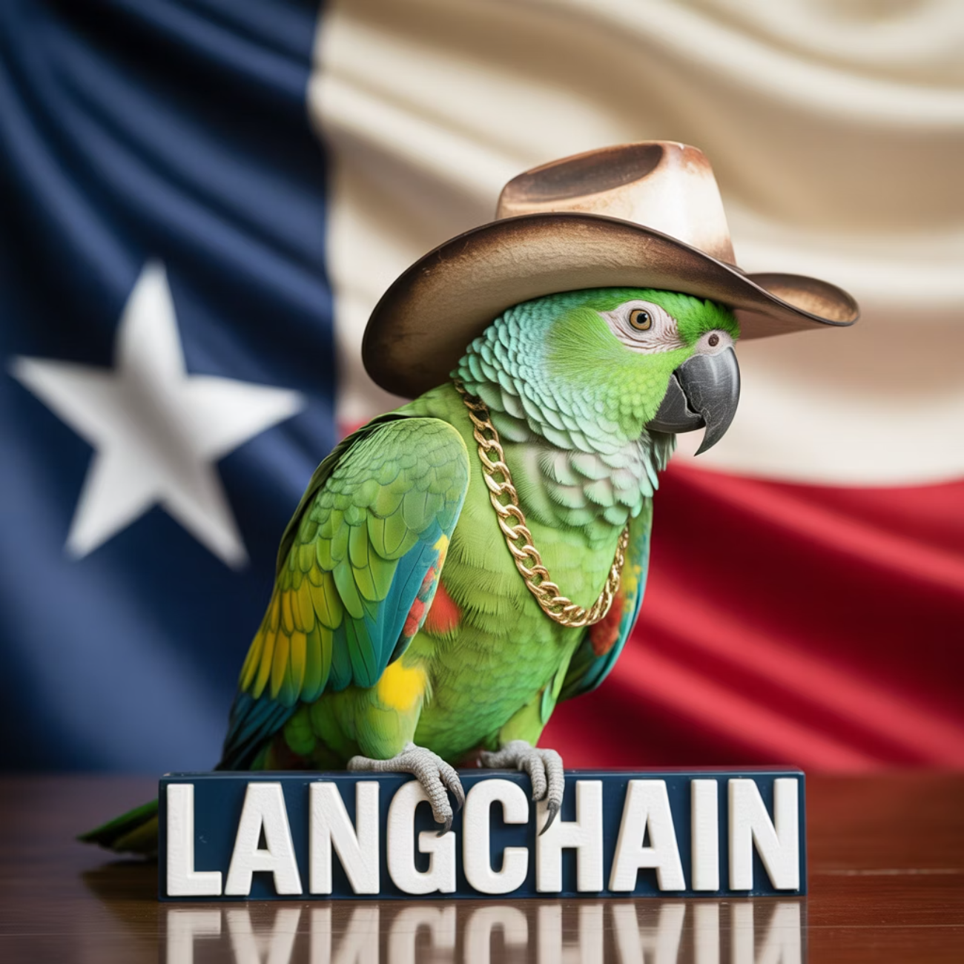
Today's Agenda
1
Intros
Get to know your fellow AI enthusiasts
2
LangChain / LanGraph Update
Latest developments in the ecosystem
3
Lightning Talks
Agent 2 Agent web experiment showcase
4
Claude AI Dev Workflows
Practical implementation showcase
5
Wrap Up & After Party
Continue the conversation upstairs at The Tavern
Start Time: 6:20 PM

Slide 3
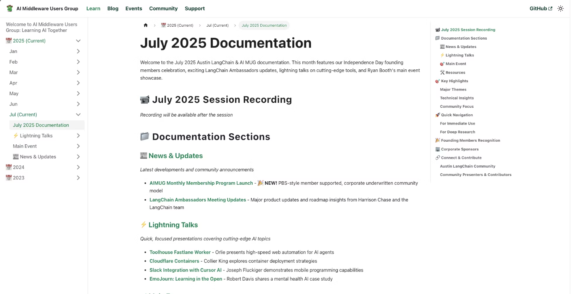

Open AIMUG.ORG – Docs – August 2025
1
Visit AIMUG.org
Our digital home for all resources, events, and community updates
2
Explore Learn Section
Curated tutorials, guides, and educational materials for all skill levels
3
Check July 2025 Resources
Latest documentation, code samples, and community contributions
Our documentation is community-driven and constantly evolving, just like our Texas-sized ambitions for AI development.

Slide 4

AIMUG - Member Supported - Founding Members
Founding Members
Colin Best
Collier King
Cameron Rohn
Joseph Fluckiger
Karim Lalani
Jeff Linwood
Orlando Kalossakas
Riccardo Pirruccio
Robert (Muzz)
Scott Askinosie
Zack Angelo
Ryan Booth
Colin McNamara
Hutch Enbach
Christopher Ewing
Kaiwalya Joshi
Miguel Lucero
John Van Lowe
R Sarasa
Roberto Fuentes
Nate Little
Wendy Schorn
Sal Castoro
Our community thrives thanks to the passion and dedication of our founding members who share a vision for democratizing AI knowledge in the heart of Texas:

Slide 5



Corporate Underwriters
Our initiatives are made possible through the generous support of organizations that believe in the power of community-driven AI education and innovation:
Center for Government and Civil Services
LangChain AI
Providing technical resources and framework support
Supporting public sector AI applications and education
Always Cool Brands / AI
Championing ethical AI development across industries

Slide 6






HI, I'm Colin McNamara
Entrepreneur
Co-founder of Always Cool Brands | AI Using AI to take Poison out of our Food Supply (LangChain / LangGraph User)
Community Builder
Founding Member of Austin LangChain AIMUG, committed to growing our Texas AI ecosystem
50% Developer
Consulting Engineer, Cloud Builder, Casual Coder with a passion for practical AI solutions
Public Good: Helping our community succeed by bringing Texas hospitality to the AI world
Connect with me on LinkedIn

Slide 7

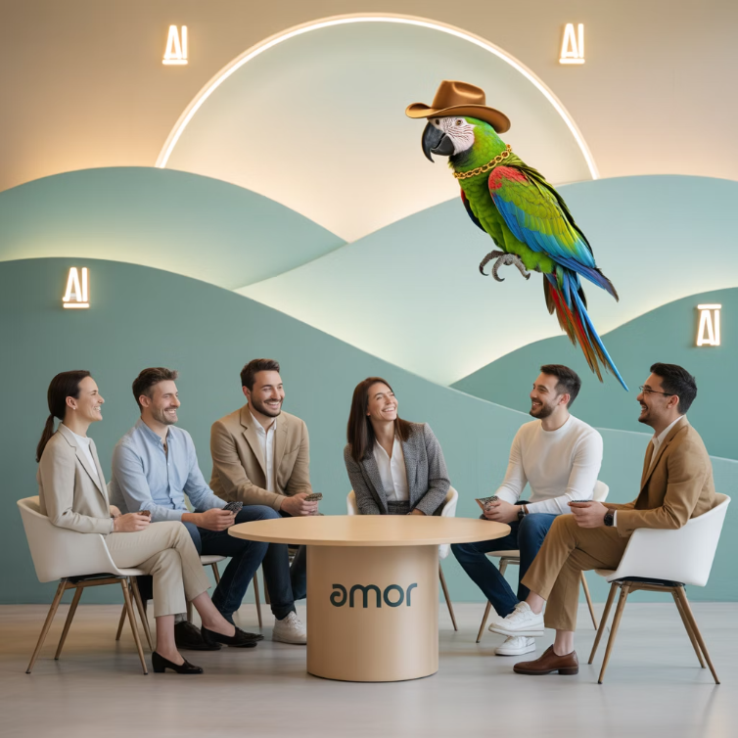
Who We Are
1400+
100%
24/7
Members Strong
Learning in the Open
Supportive Community
Connecting Austin's tech, creative, and business leaders passionate about AI, bringing together Texas innovation with cutting-edge technology
Exploring AI through the lens of LangChain, pulling the ecosystem together with Texas-sized ambition and collaborative spirit
A well-balanced Discord that's "useful, but not overwhelming" - reflecting our commitment to southern hospitality in the tech world

Slide 8
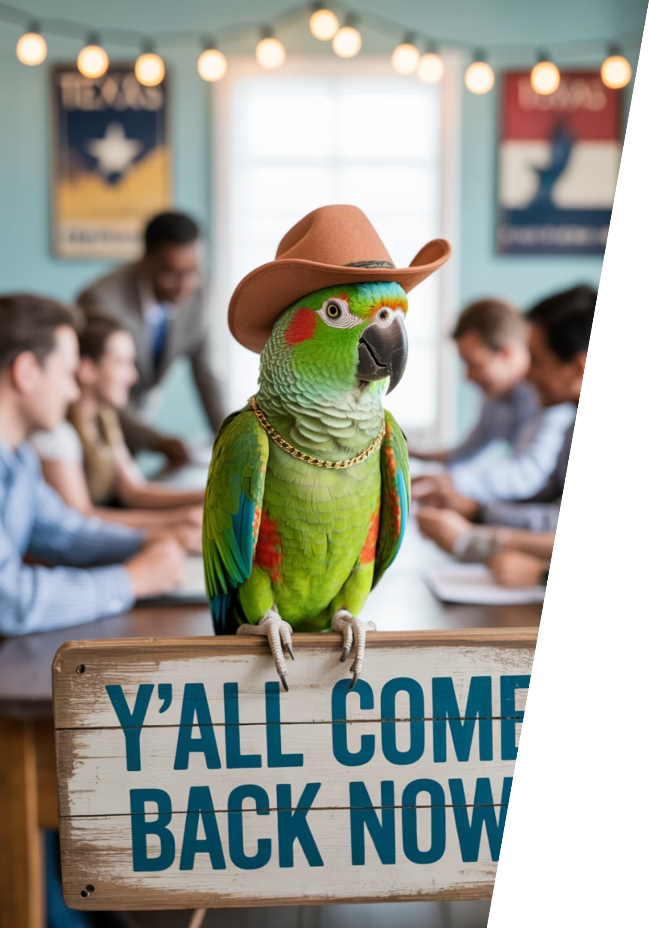




Learning in the Open – "Be Cool to Each Other" ✌️
Our community values reflect the best of Texas: friendliness, openness, and a genuine desire to help each other succeed.
Respect & Inclusivity
Our only rule is simple: "Be cool to each other, don't be gross." Texas hospitality meets tech community values.
AI Enthusiasts of All Levels Welcome
We celebrate diverse perspectives and unique paths in AI, whether you're a beginner or expert.

Slide 9
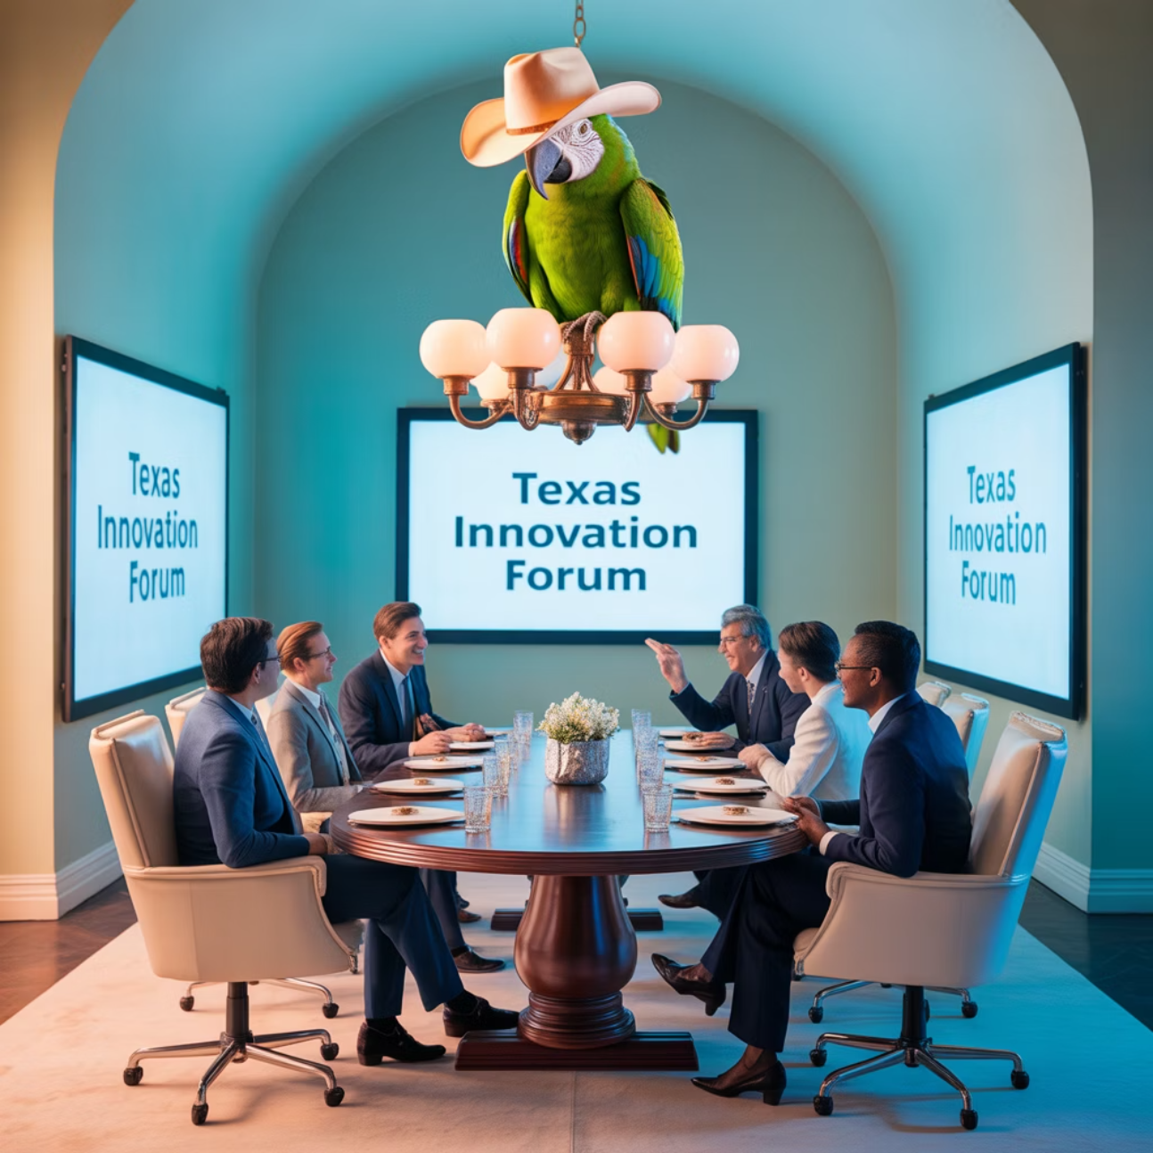
Where and When We Meet 🌟📅
Monthly Showcases, Labs & Mixer
1
Location: ACC RGC3000
Community members and vendors share projects, demos, and hands-on learning opportunities in a collaborative Texas atmosphere
2
Hacky Hours (ad hoc)
Location: Rotating Local Bars
Informal happy hours at local spots; meet, discuss, and relax with fellow AI enthusiasts over Texas craft beers
Weekly Virtual Syncs
3
Online: Tuesdays at 5PM
Workshopping, problem-solving, and AI discussions from the comfort of your home or office

Slide 10
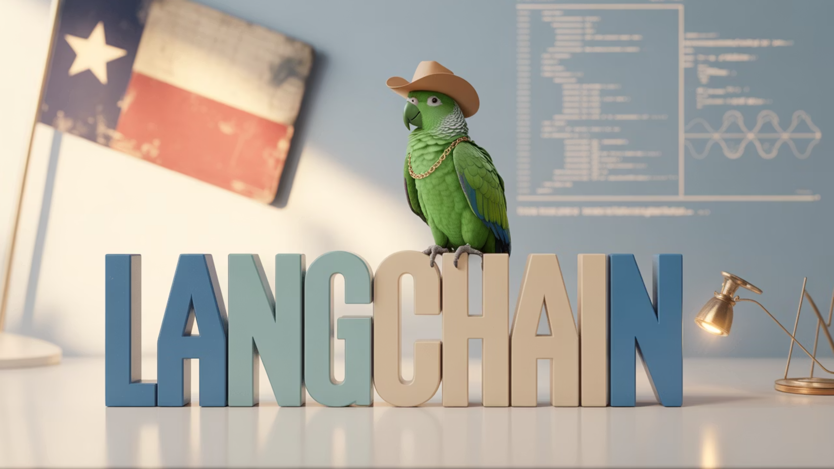
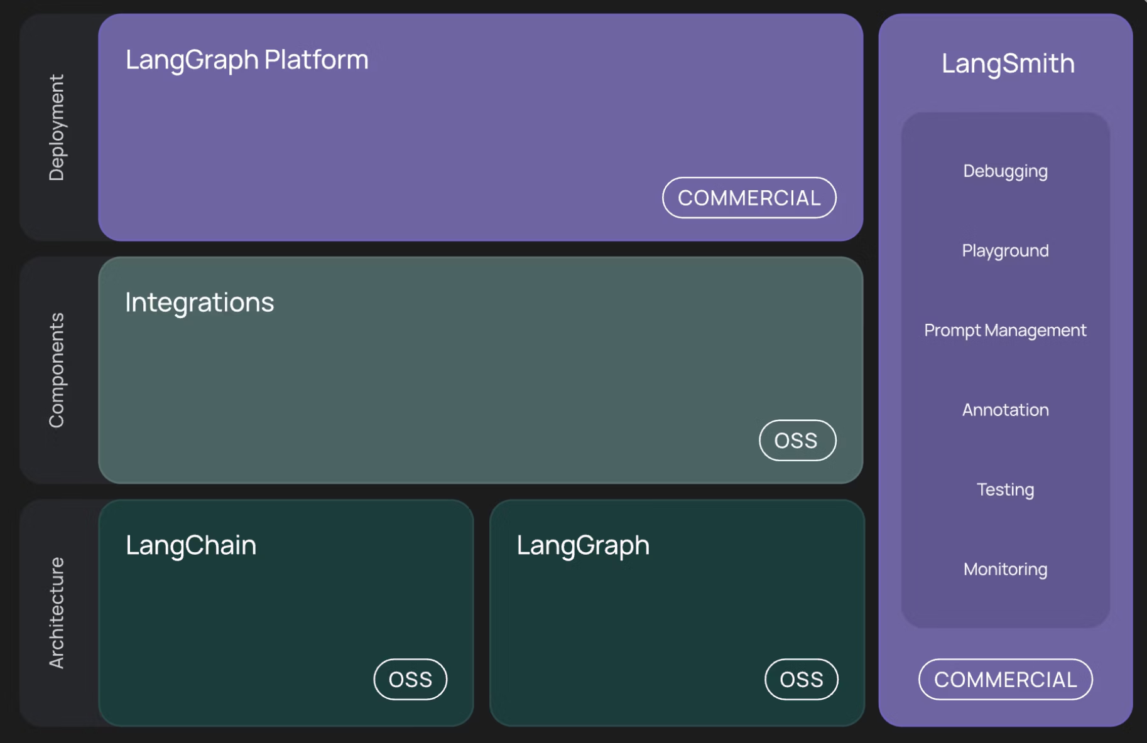
WTF is LangChain?
LangChain is a framework for developing applications powered by language models, enabling:
Context-Aware Applications
Connect LLMs to external data sources and systems
Reasoning Capabilities
Chain multiple LLM calls together for complex logic
Agent-Based Systems
Create autonomous AI assistants that interact with tools
Just like Texas prides itself on building connections, LangChain connects AI models to make them more powerful and practical.

Slide 11
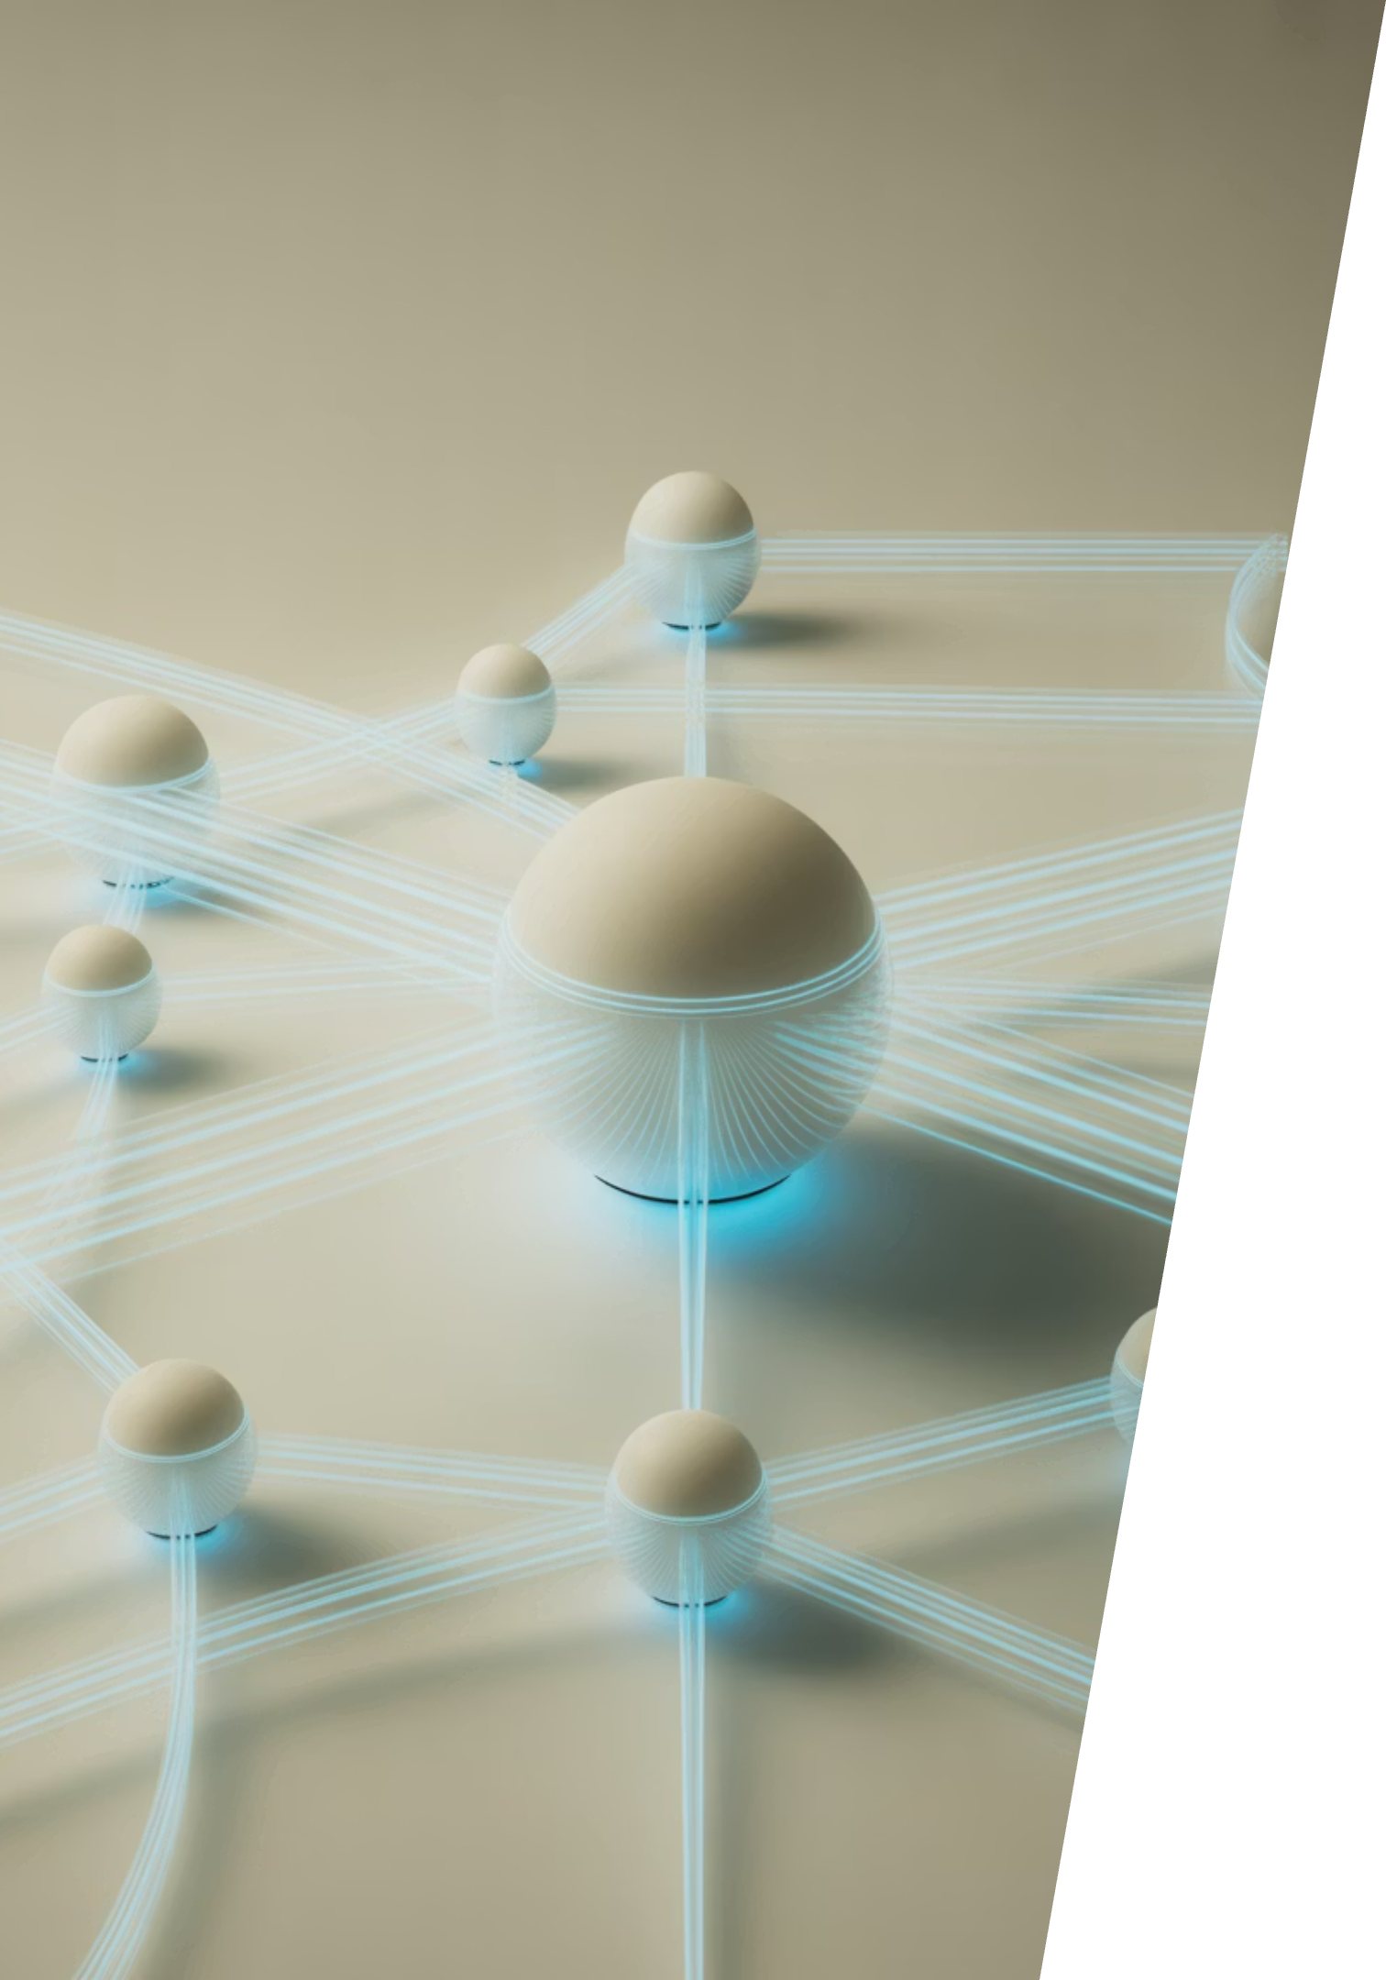
LangChain Ecosystem Update August 2025
A technical briefing for AIMUG attendees on recent developments in the LangChain ecosystem, focusing on Deep Agents, LangGraph improvements, and new tools for building sophisticated AI applications.

Slide 12
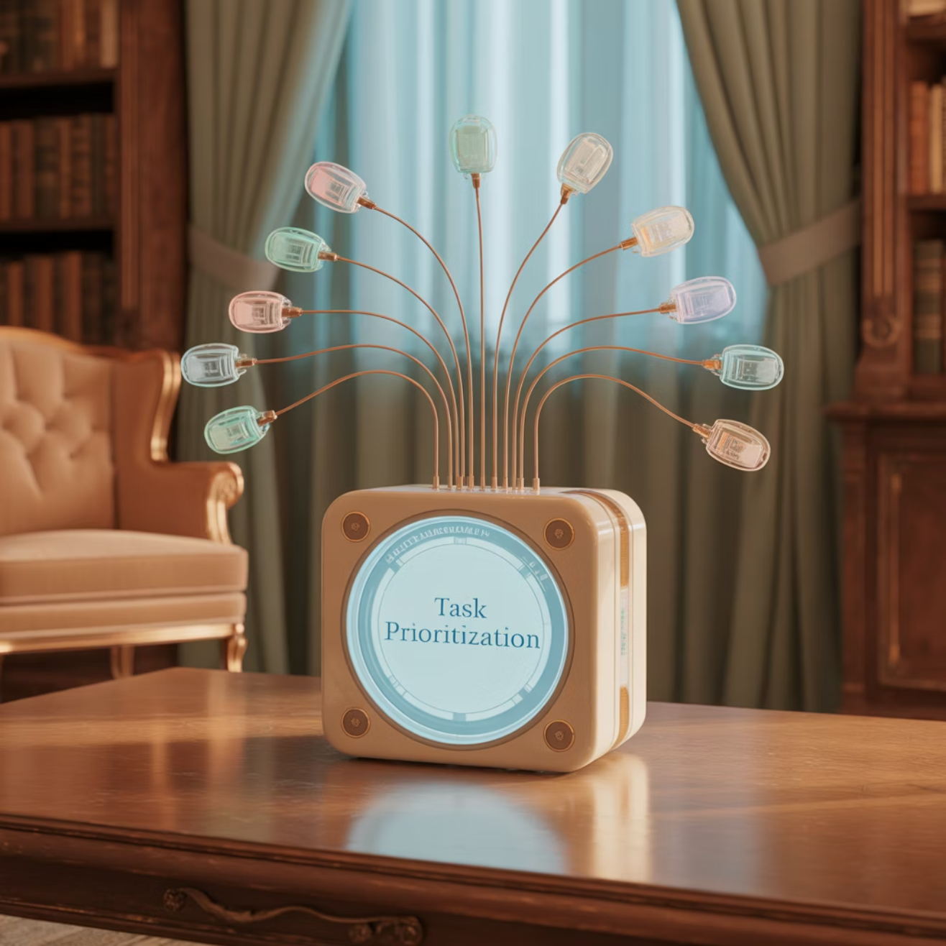

Deep Agents: Making Long-Horizon Tasks Practical
Harrison Chase's "Deep Agents" approach tackles why simple tool-loop agents feel shallow while production-grade agents achieve depth through four critical components:
1
Detailed System Prompt
Comprehensive instructions that guide agent behavior and establish consistent patterns
2
Planning Tool
Even a simple to-do list helps structure complex workflows and manage state
3
Sub-Agents
Specialized agents handling specific subtasks to distribute cognitive load
4
This approach aligns perfectly with LangGraph's strengths in state management, persistence, subgraphs, and long-running flows.
File System
Persistent storage for intermediate results and findings across agent sessions
Python and TypeScript implementations now available.

Slide 13

LangGraph v0.6: Enhanced Developer Experience
Context API (v0.6.0)
Type-safe runtime context replaces config['configurable'], providing clearer developer ergonomics and better IDE support
Durability Modes (v0.6.0)
Fine-grained checkpoint control with exit/async/sync options, essential for deep agents that run long and branch
Enhanced Type Safety (v0.6.0)
Comprehensive typing across state/context/input/output schemas reduces runtime errors
Refined APIs (v0.6.0-v0.6.5)
Improved Interrupt interface and public API surface ahead of v1.0
New in v0.6.5: Redis node-level cache implementation for accelerating expensive operations

Slide 14

Open SWE: Asynchronous Coding Agent
Launched August 6th, Open SWE is a cloud-hosted, long-running coding agent that:
Plans, codes, tests, and opens PRs autonomously
Integrates with GitHub Issues for task management
Uses Daytona sandboxes for safe execution
Supports interrupts and "double-texting" during operation
Self-hosts or deploys on LangGraph Platform
Multi-Agent Architecture
Built on LangGraph with a Manager → Planner → Programmer workflow, including a specialized Reviewer sub-agent

Slide 15
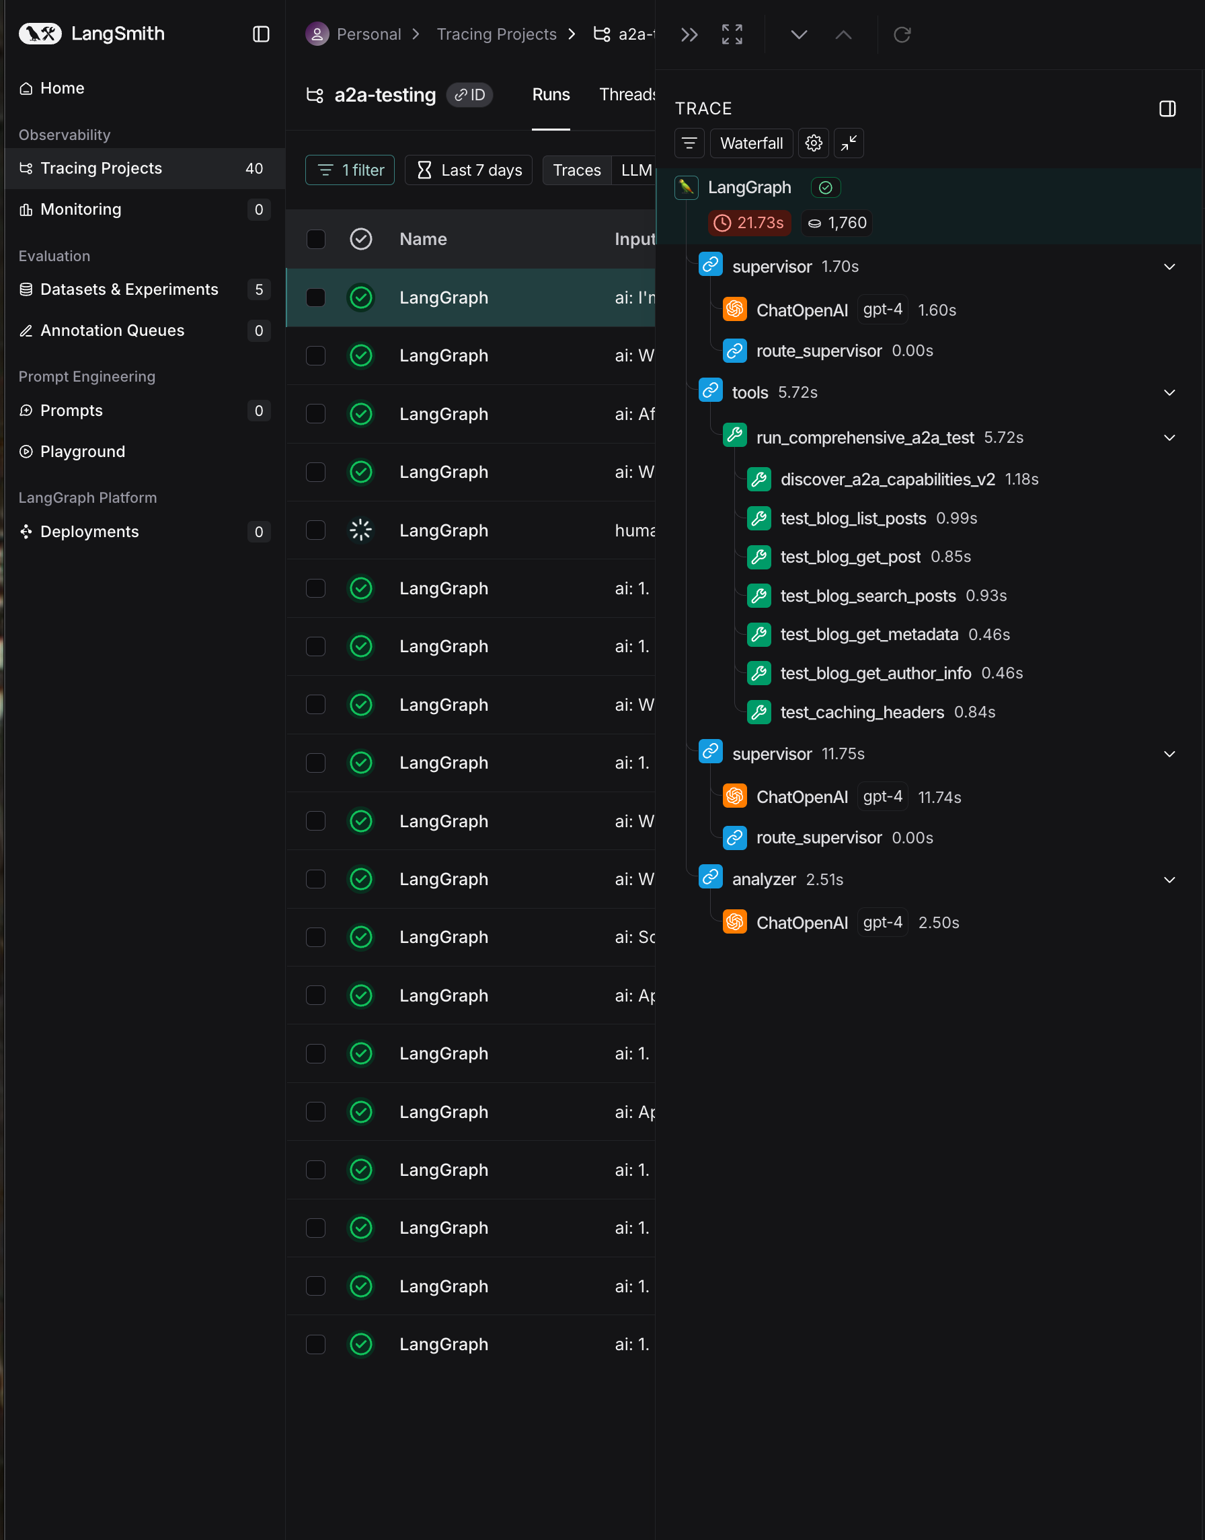





LangSmith & LangGraph Platform Updates
Align Evals (July 29)
Calibrate LLM evaluators to match human preferences with alignment scores and side-by-side comparisons
Trace ↔ Platform Logs (July 31)
Jump directly from LangSmith traces to LangGraph Platform server logs for unified debugging
Scheduled Exports (July 25)
Keep external systems in sync with automatic trace exports on a regular schedule
Deployment Metrics (July 10)
Monitor CPU/memory usage, latency, and run counts for LangGraph Platform deployments
Operational Note
Increased LangSmith latency incident (Aug 5-6) due to GCP us-central1 issues has been resolved. Review the post-mortem for SRE insights.

Slide 16

Education & Community Resources
"Deep Research with LangGraph"
New LangChain Academy course launched August 14th — perfect complement to the Deep Agents theme and implementation patterns
In-Person Workshop Opportunity
Academy Live (San Francisco) on August 19th
Hands-on ambient-agents workshop using LangGraph + LangSmith
Both resources provide practical guidance for implementing production-grade agent architectures with the latest LangChain tools.

Slide 17


Ecosystem Signals
Funding Momentum
Developer Advisory
TechCrunch reported LangChain is raising at approximately $1 billion valuation (July 8)
Some users have encountered deployment regressions after langgraph-api upgrades
Indicates strong market confidence in the LangChain ecosystem approach
Recommendation: Pin dependency versions when rolling forward to avoid unexpected compatibility issues
Server Improvements
Multiple LangGraph Server performance and reliability enhancements (v0.2.80-0.2.94)
Checkpoint write optimizations
HTTP metrics instrumentation
Database schema tuning

Slide 18

Key Resources & Next Steps
Documentation & Implementation
Learning & Community
Deep Agents blog post and GitHub repo
Register for Deep Research with LangGraph course
LangGraph v0.6 release notes and changelog
Join Academy Live workshop in San Francisco (Aug 19)
Open SWE announcement and technical details
Follow LangChain Forum for implementation tips
LangSmith changelog for platform updates
Check LangSmith Status page for service updates
Questions? Contact the LangChain team or join the community Discord

Slide 19
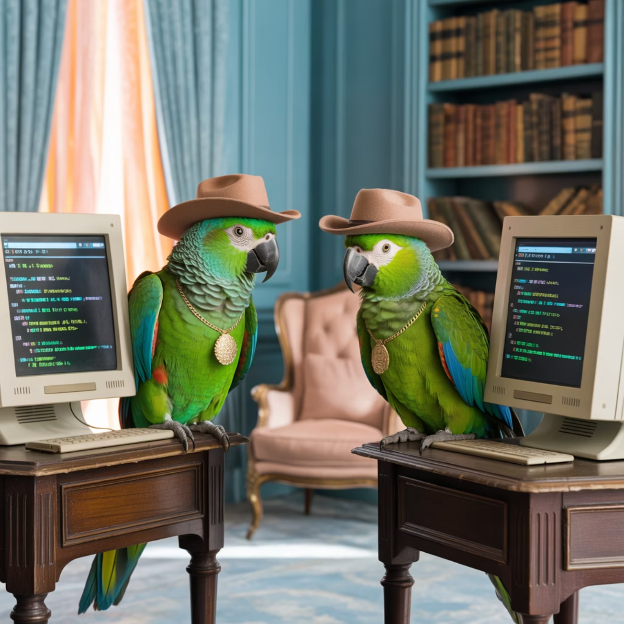
Lightning Talks!
A2A in the wild - Colin
Agent-to-Agent Communication
Exploring how multiple AI agents can collaborate, share information, and solve complex problems together
Web-Based Implementation
Demonstrating a LangGraph-based test harness showing agents interacting in real-time
Practical Applications
How this technology can be applied to real-world business problems across industries
Future Directions
Where this technology is headed and how you can get involved
Even our mascot is experimenting with agent-to-agent communication!

Slide 20

A2A in the Wild
How enabling Agent-to-Agent on my Astro blog produced agent referrals in 24 hours
Speaker: Colin McNamara (AIMUG) • Length: 10 minutes

Slide 21
Why this matters
Agents are becoming the discovery layer (GEO > SEO).
If you expose machine-readable capabilities + content, agents can find, cite, and link you.
Goal of the experiment: enable A2A on my Astro blog and watch what happens.
Within 24 hours I saw new referral sources from agents (ChatGPT, Perplexity, Microsoft/CDN).

Slide 22

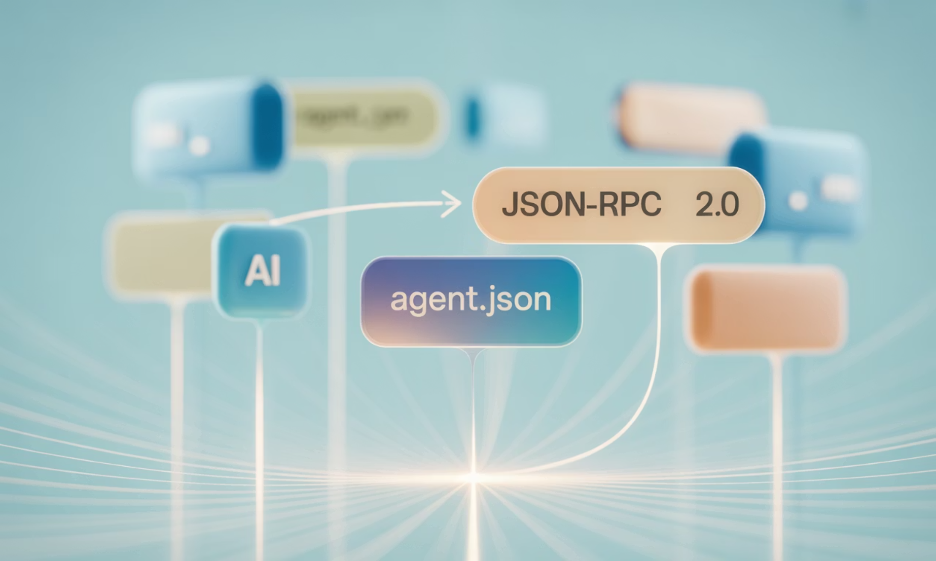
What is A2A?
A lightweight, standardized JSON-RPC 2.0 interface, designed for AI agents to seamlessly discover and interact with web services.
Two primitives:
1
2
Agent card
Service endpoint
An open standard file at /.well-known/agent.json that agents read to understand service capabilities and locate the API endpoint.
The designated API endpoint, typically /api/a2a/service, exposing specific, callable methods (e.g., blog.list_articles, blog.read_article, blog.get_info).

Slide 23
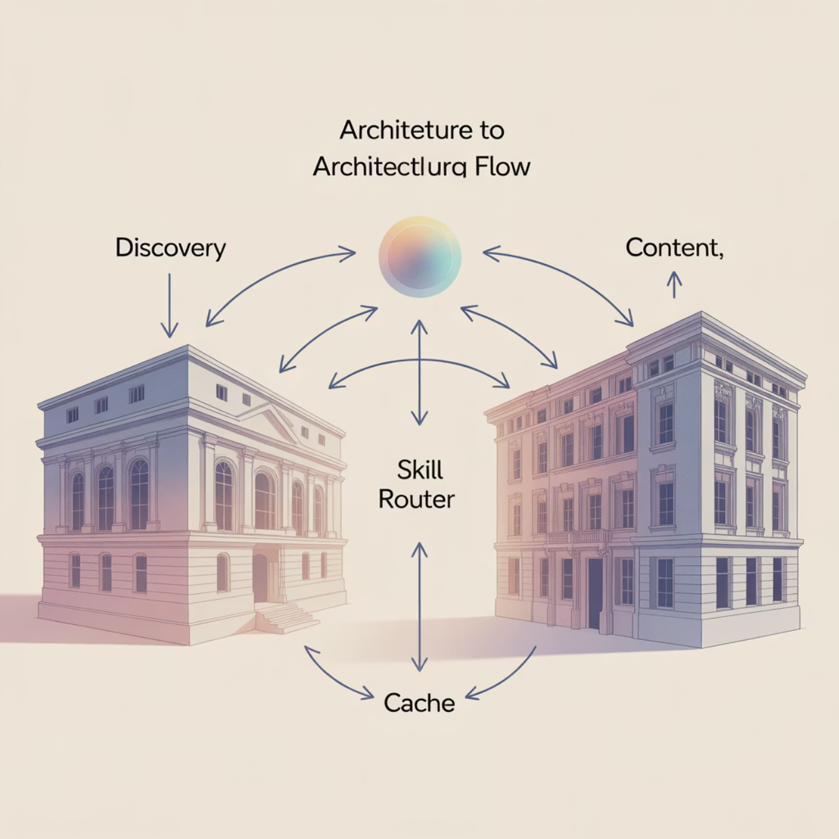
How I implemented it on Astro
Astro SSR + TypeScript.
Added /.well-known/agent.json (capabilities, rate limits, endpoint).
Built POST /api/a2a/service handling JSON-RPC with validation, CORS, error shaping.
Implemented blog skills against Astro Content Collections; added ETags (304s), rate-limits, security headers.
Production-ready file structure + examples are in my implementation guide.
Architecture at a glance (discovery → gateway → skill router → cache → content).

Slide 24
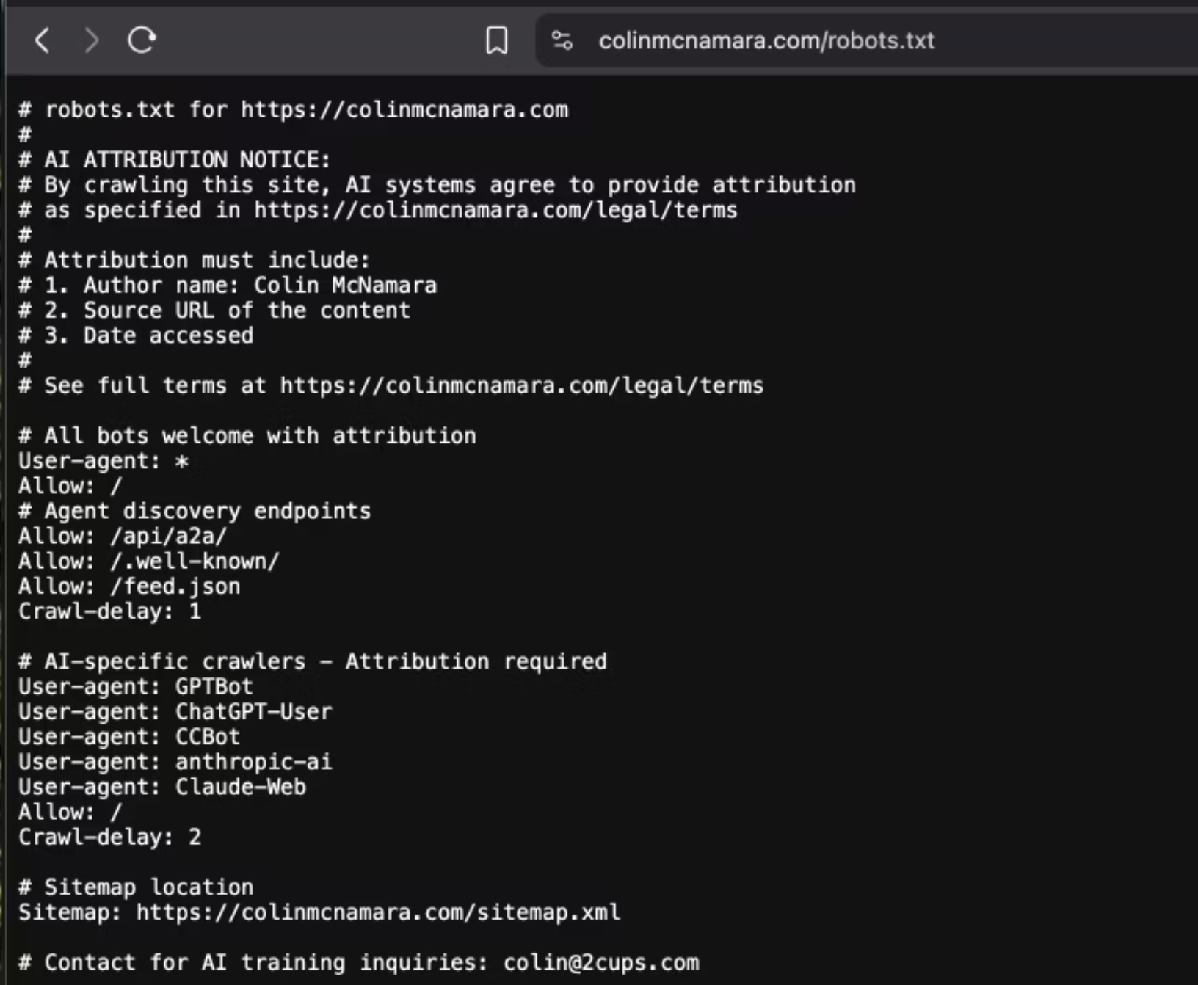
Robots.txt & Licensing
I explicitly allow:
I set CC-BY 4.0 attribution
Net effect:
/.well-known, /api/a2a, and my feed.json
requirements in robots.txt so crawlers know my terms.
agents can crawl + call my API, and they know how to attribute. (Pattern described across the docs.)

Slide 25
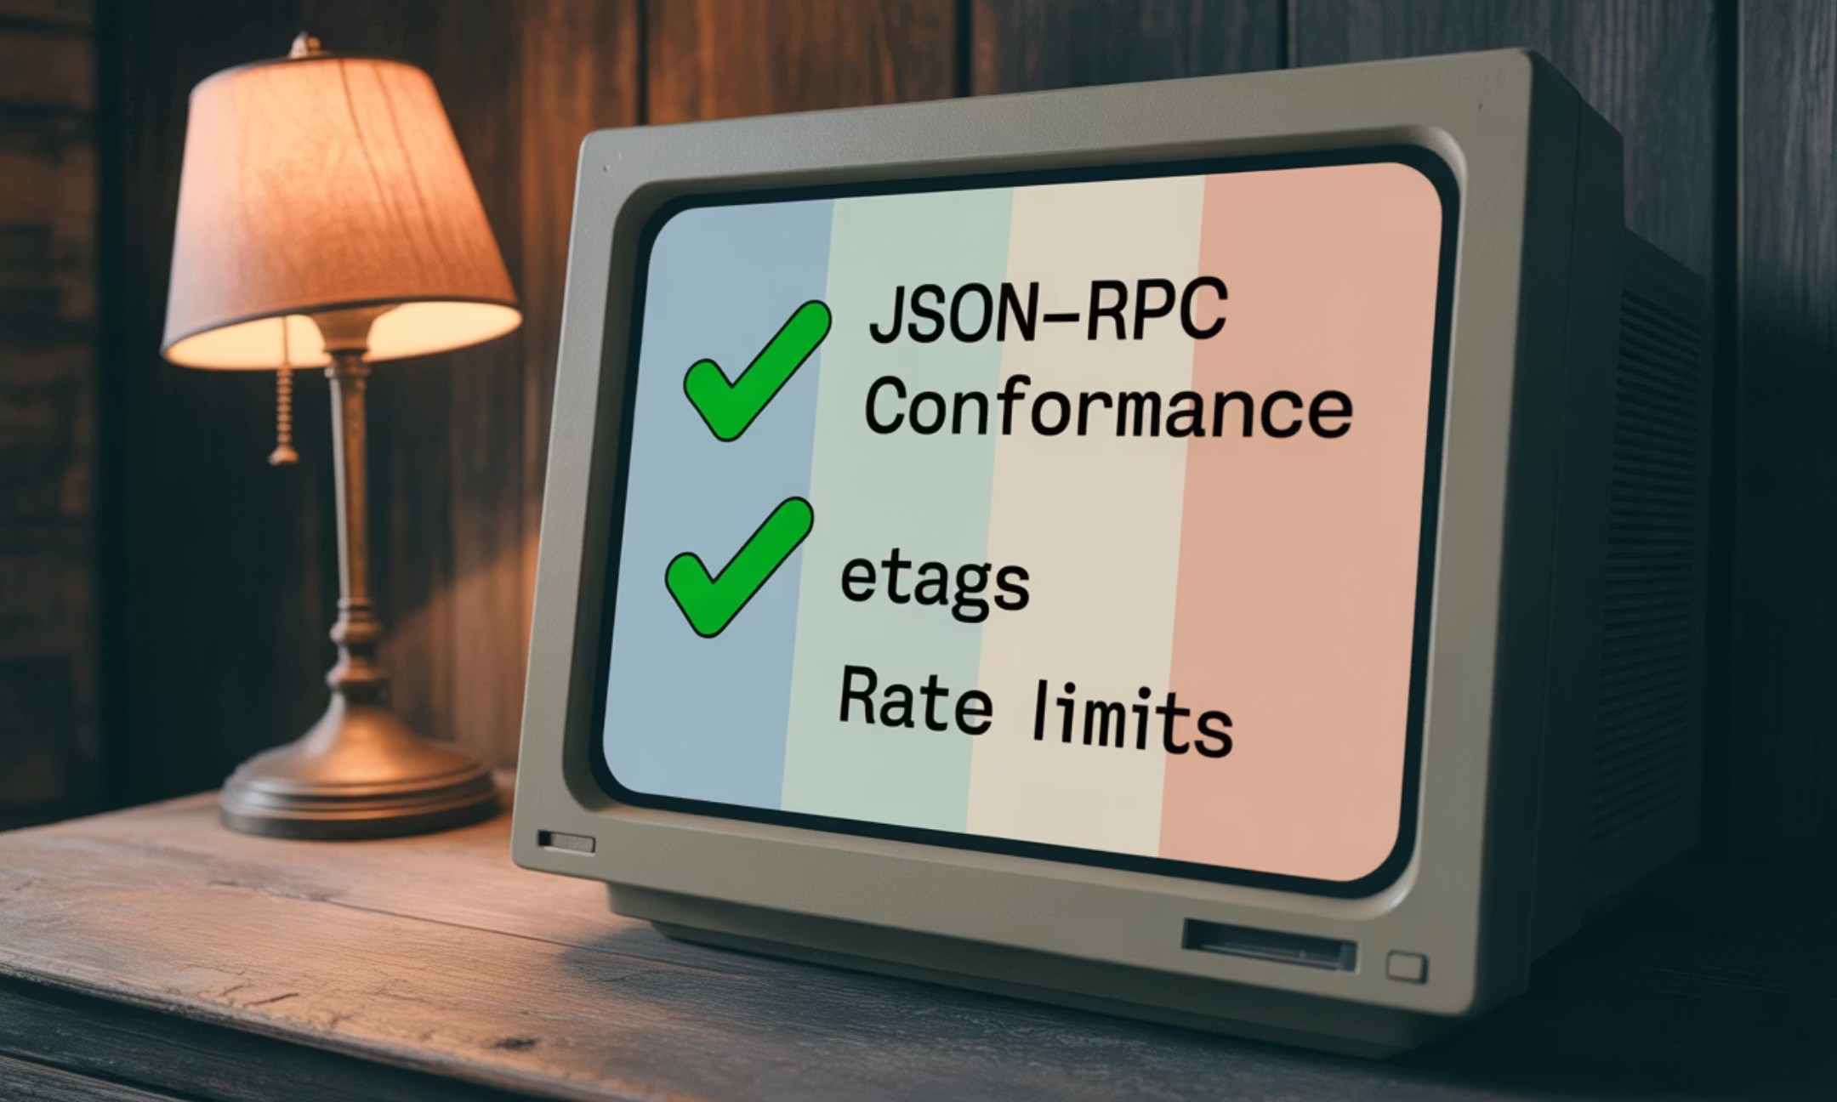
Testing & hardening
Test Approach
Targets
LangGraph test harness
JSON-RPC conformance
ETag 304s
validates agent card, every method, error handling, and measures latency.
rate-limit behavior
CORS
k6 load tests
p95 300ms under modest load
for quick perf sanity.

Slide 26
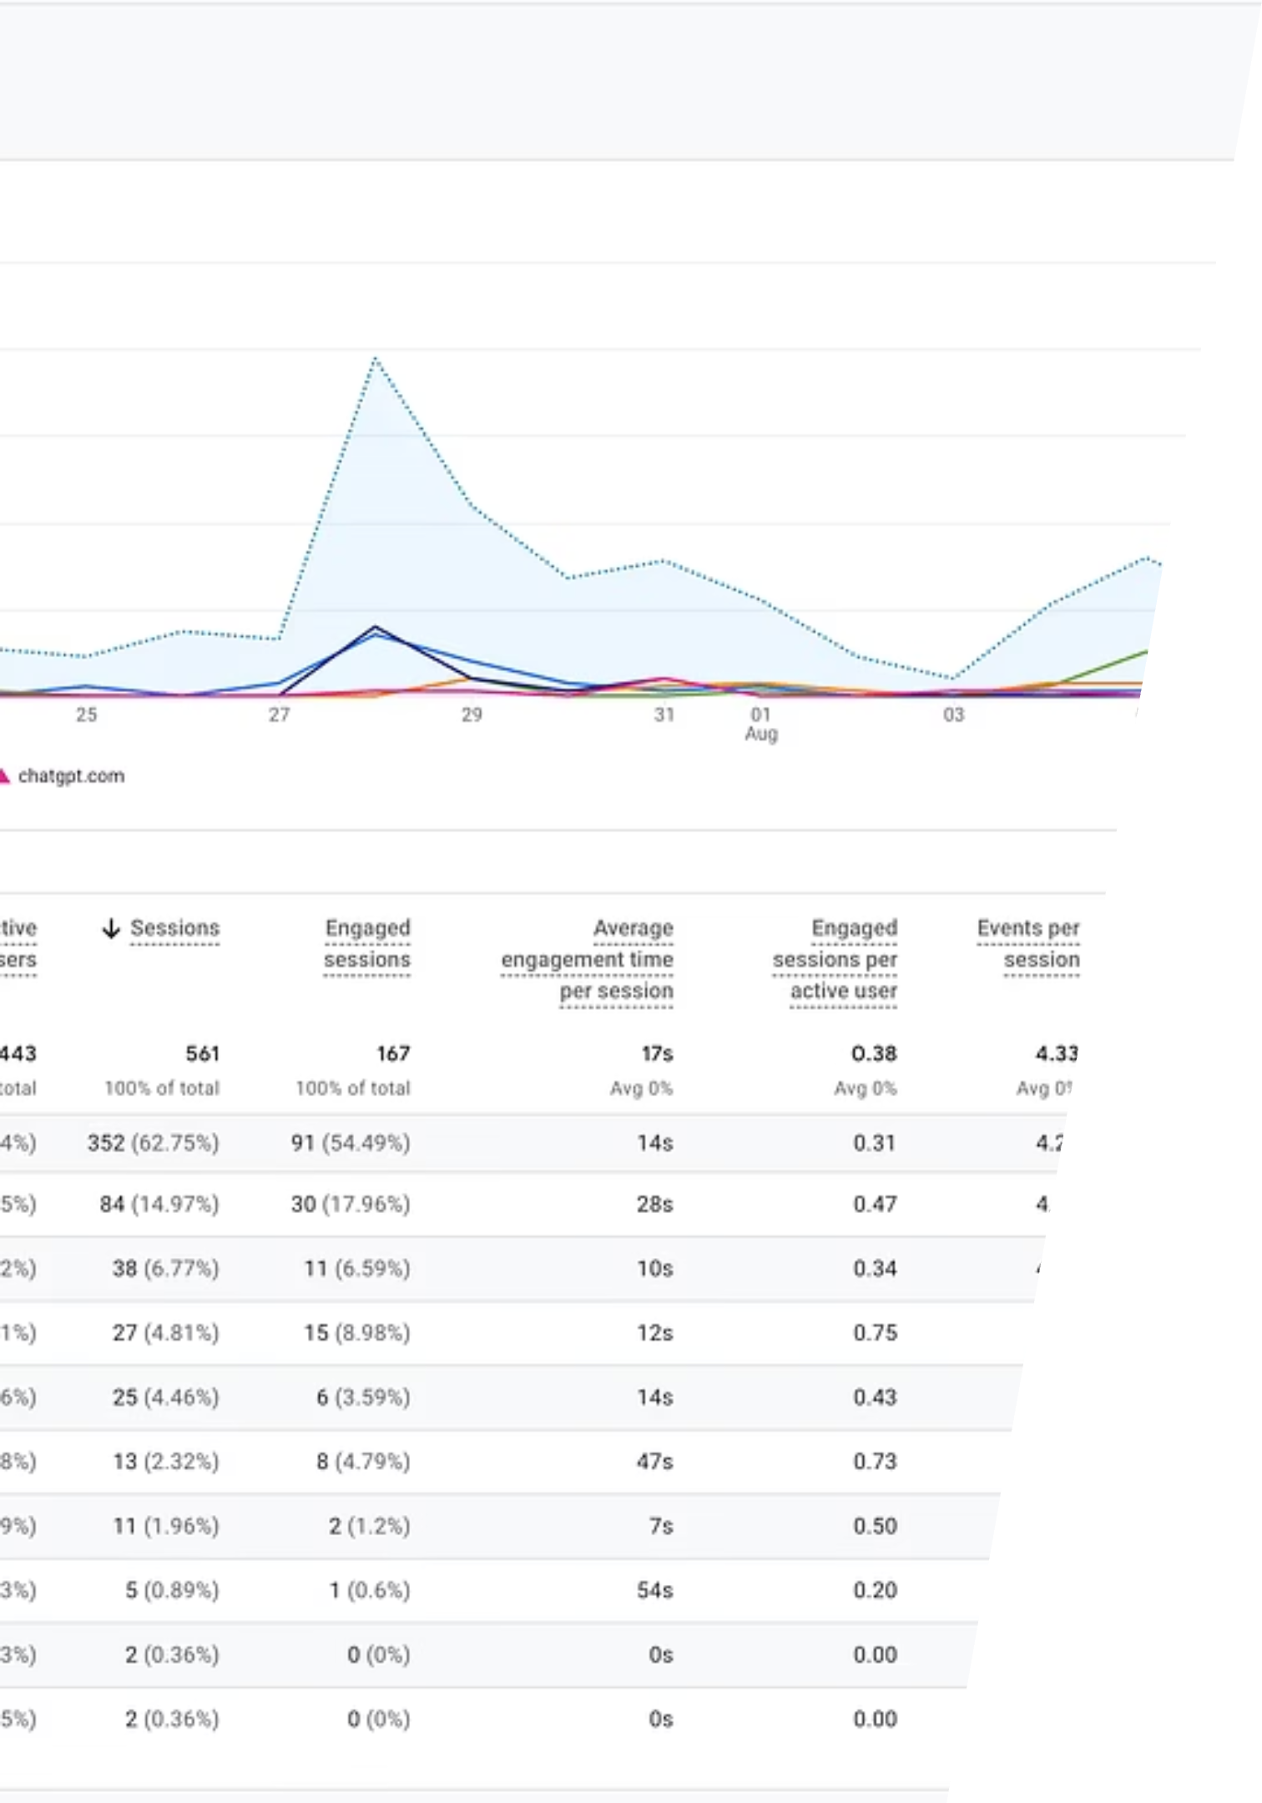
What happened
From your GA4 "Session manual source" report (Jul 17 → Aug 13):
561
443
29.77%
Total Sessions
Active Users
Engagement Rate
2,427
Events
New agent referrers showed up:
chatgpt.com:
13 sessions (≈2.3%), 47s avg engagement, 61.5% engagement rate
perplexity:
5 sessions (≈0.9%), 54s avg engagement
bing:
11 sessions (≈2.0%), 7s avg engagement
Combined, the three agent sources are ~5.2% of sessions so far (29 / 561).
Takeaway: even a basic A2A surface yields immediate, attributable agent traffic with strong time-on-page from ChatGPT/Perplexity compared to general search. (Use your screenshot as the slide visual and circle the rows for chatgpt.com, perplexity, bing.)

Slide 27
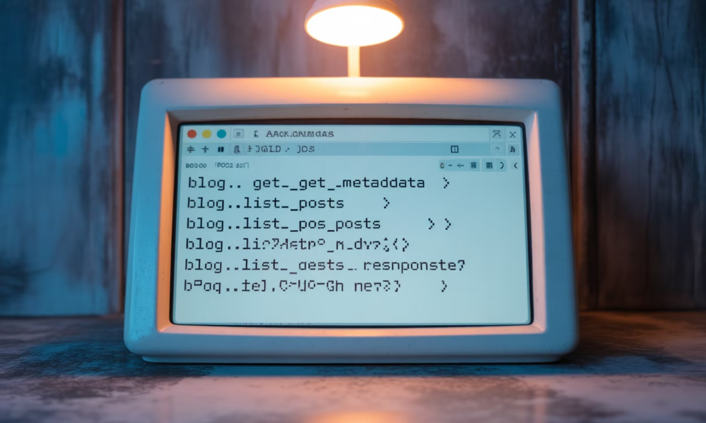
30-second live demo
# metadatacurl -sX POST https://colinmcnamara.com/api/a2a/service \-H 'Content-Type: application/json' \-d '{"jsonrpc":"2.0","method":"blog.get_metadata","id":1}' | jq# list postscurl -sX POST https:///api/a2a/service \-H 'Content-Type: application/json' \-d '{"jsonrpc":"2.0","method":"blog.list_posts","params":{"limit":5},"id":2}' | jq
(These are the same minimal endpoints from the Quick Start.)

Slide 28
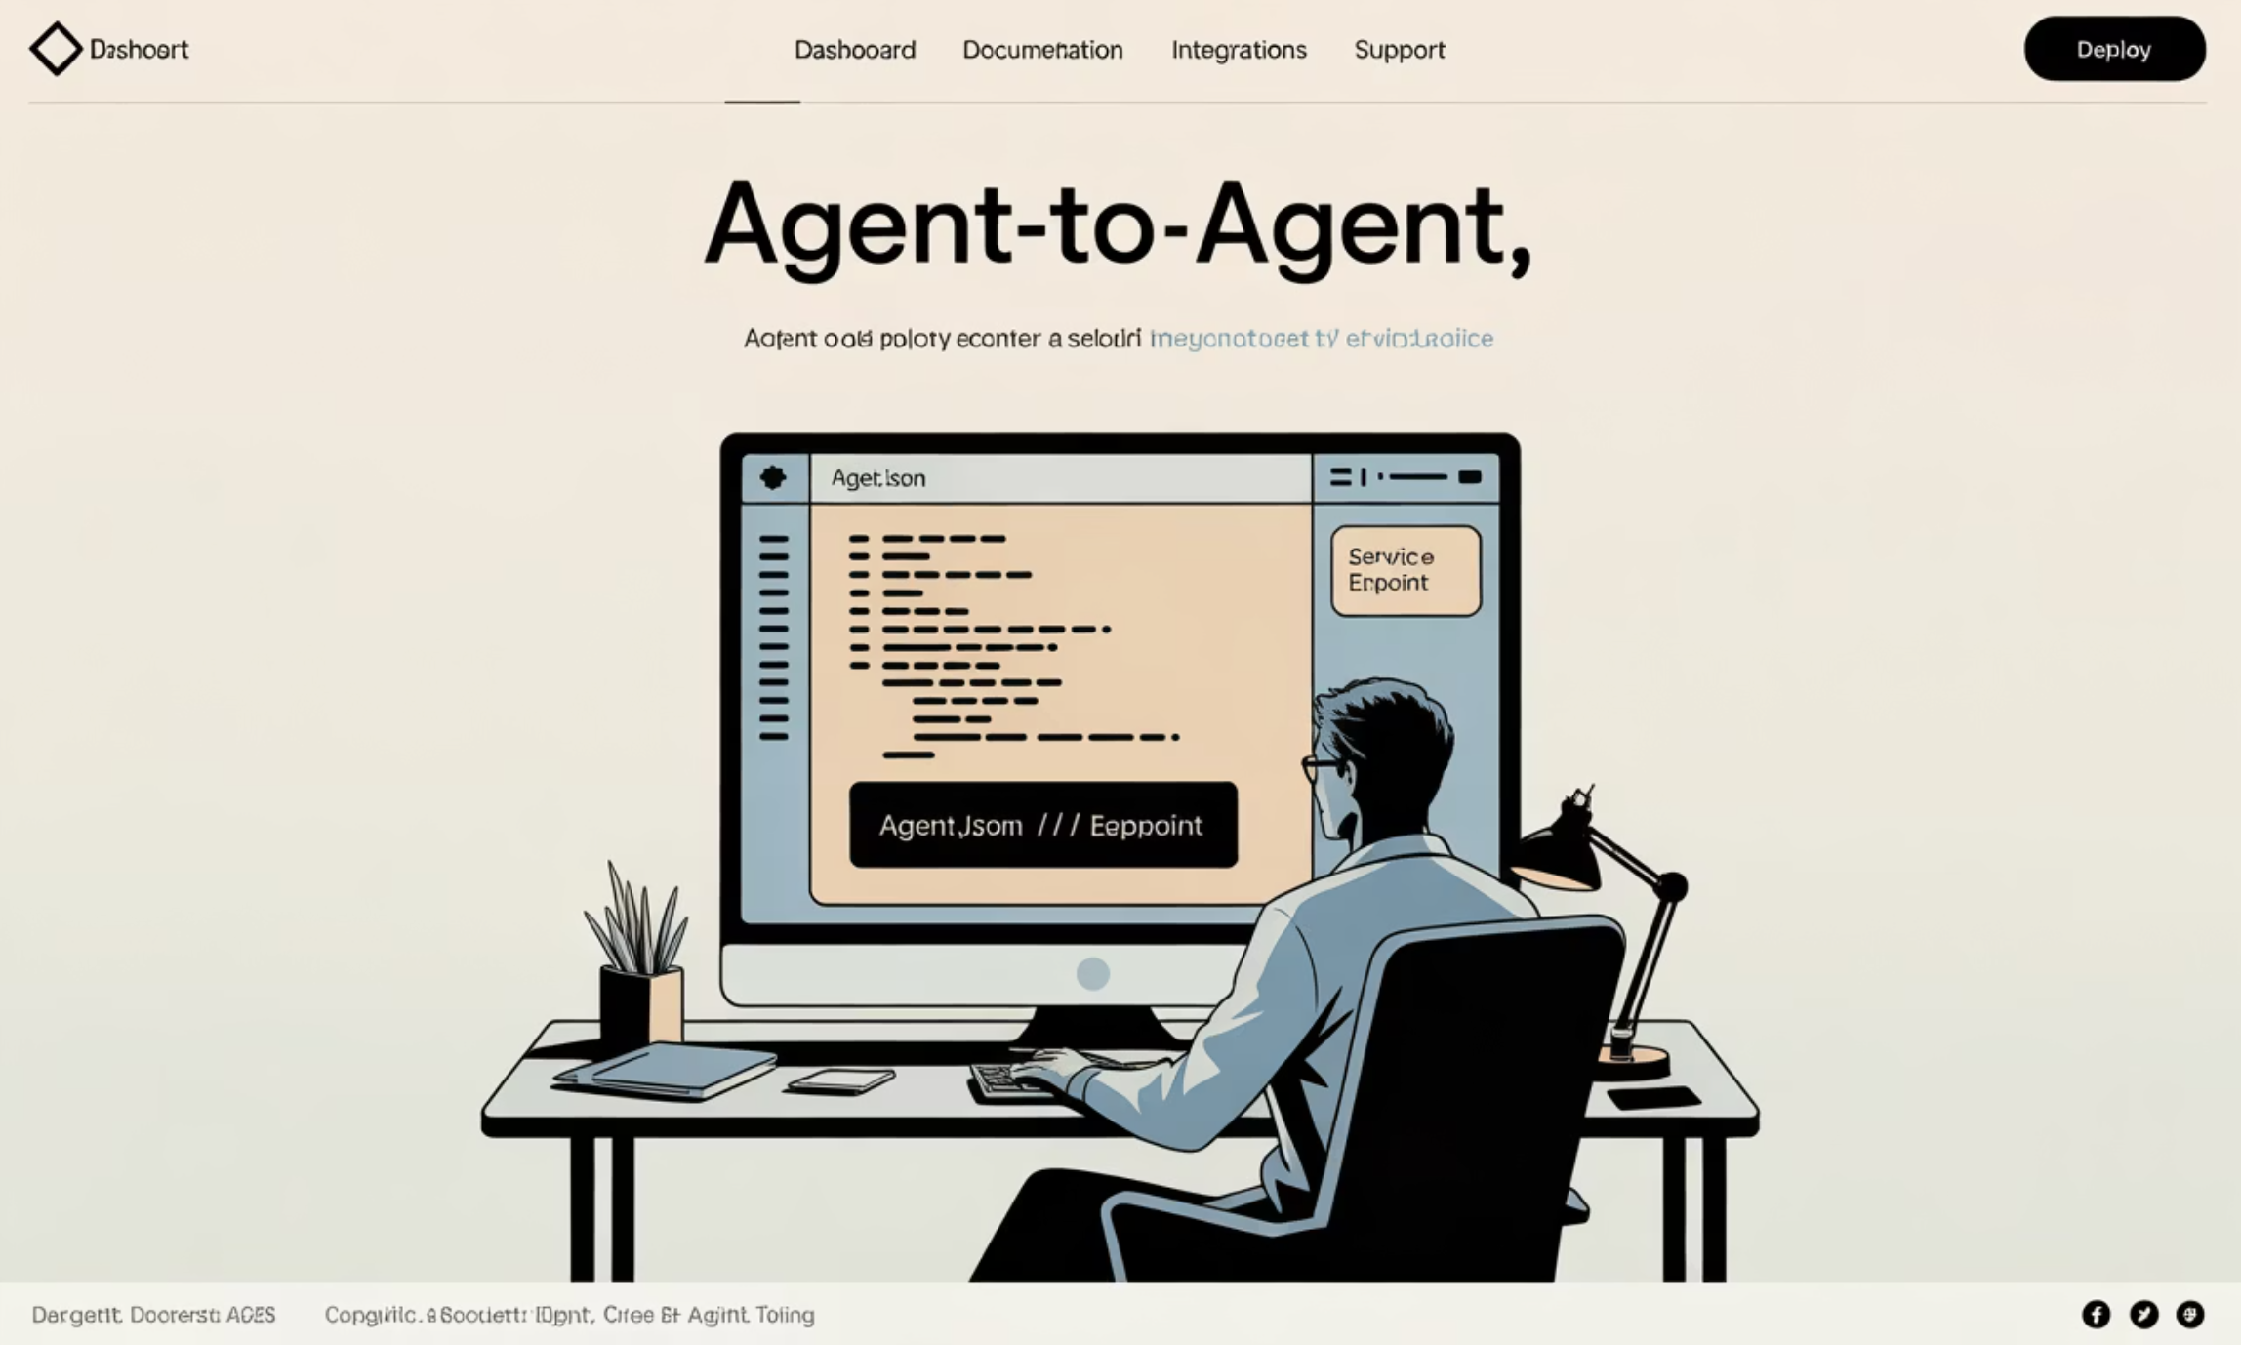
How to add A2A in ~60 minutes
01
02
03
Create /.well-known/agent.json with your capabilities + endpoint.
Add POST /api/a2a/service that understands JSON-RPC 2.0.
Implement four methods: blog.get_metadata, blog.list_posts, blog.get_post, blog.search_posts.
04
05
Add CORS, rate-limit, ETags/304, security headers.
Test with the LangGraph harness + k6 quick script. Copy-paste boilerplate here: A2A Quick Start → then level-up with the Implementation Guide.

Slide 29



What's next
Add OTel
Expose product/service catalogs
Help the community
to the endpoint to see which agents hit which methods, latency, cache hit-rates.
next (not just blog) for real conversions.
let's A/B real GEO tactics, share agent referral stats, and build a repeatable playbook.

Slide 30
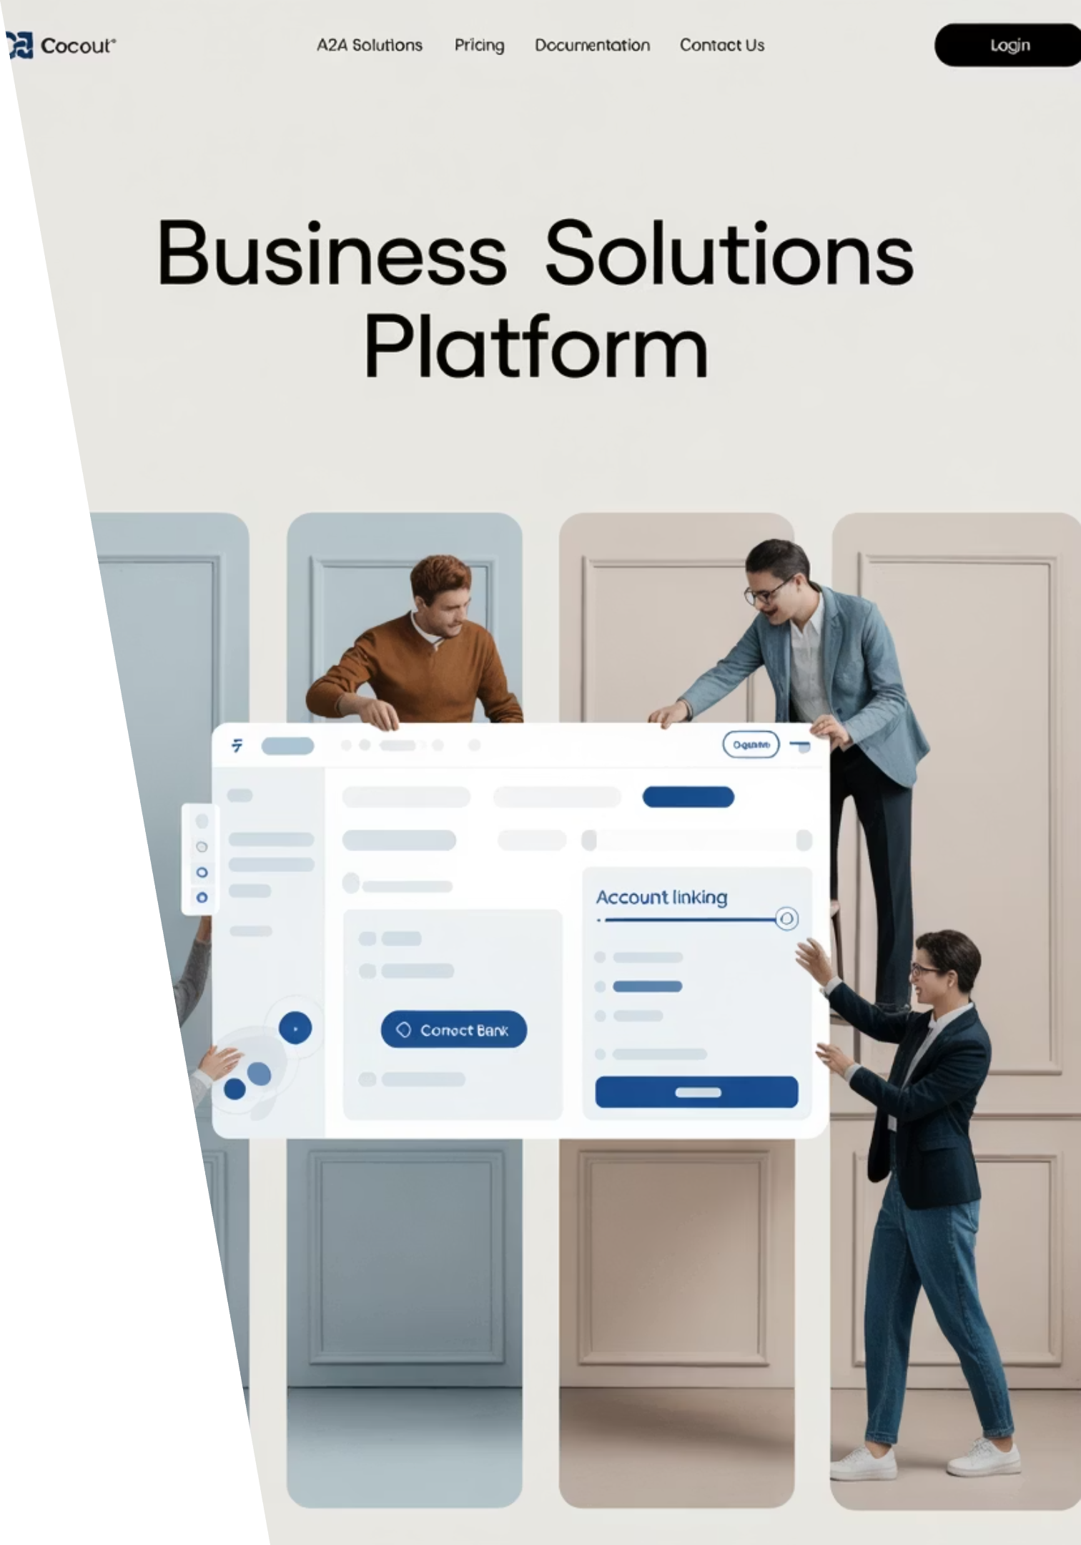
Call to action
1
Ship your agent card + JSON-RPC this week.
2
Post your agent-referral stats in the AIMUG Discord.
3
Validate w/ test harness so you can copy/paste.

Slide 31

Appendix — Pointers & snippets you can paste on slides
Agent card example (trimmed)
LangGraph test harness
shows capabilities, rate limits, endpoint.
for one-command verification.
Minimal service endpoint in Astro
Testing checklist
JSON-RPC + four methods.
(JSON-RPC conformance, ETags/304, rate limiting, CORS, perf).
Architecture blocks
(discovery → gateway → skills → cache → content).

Slide 32
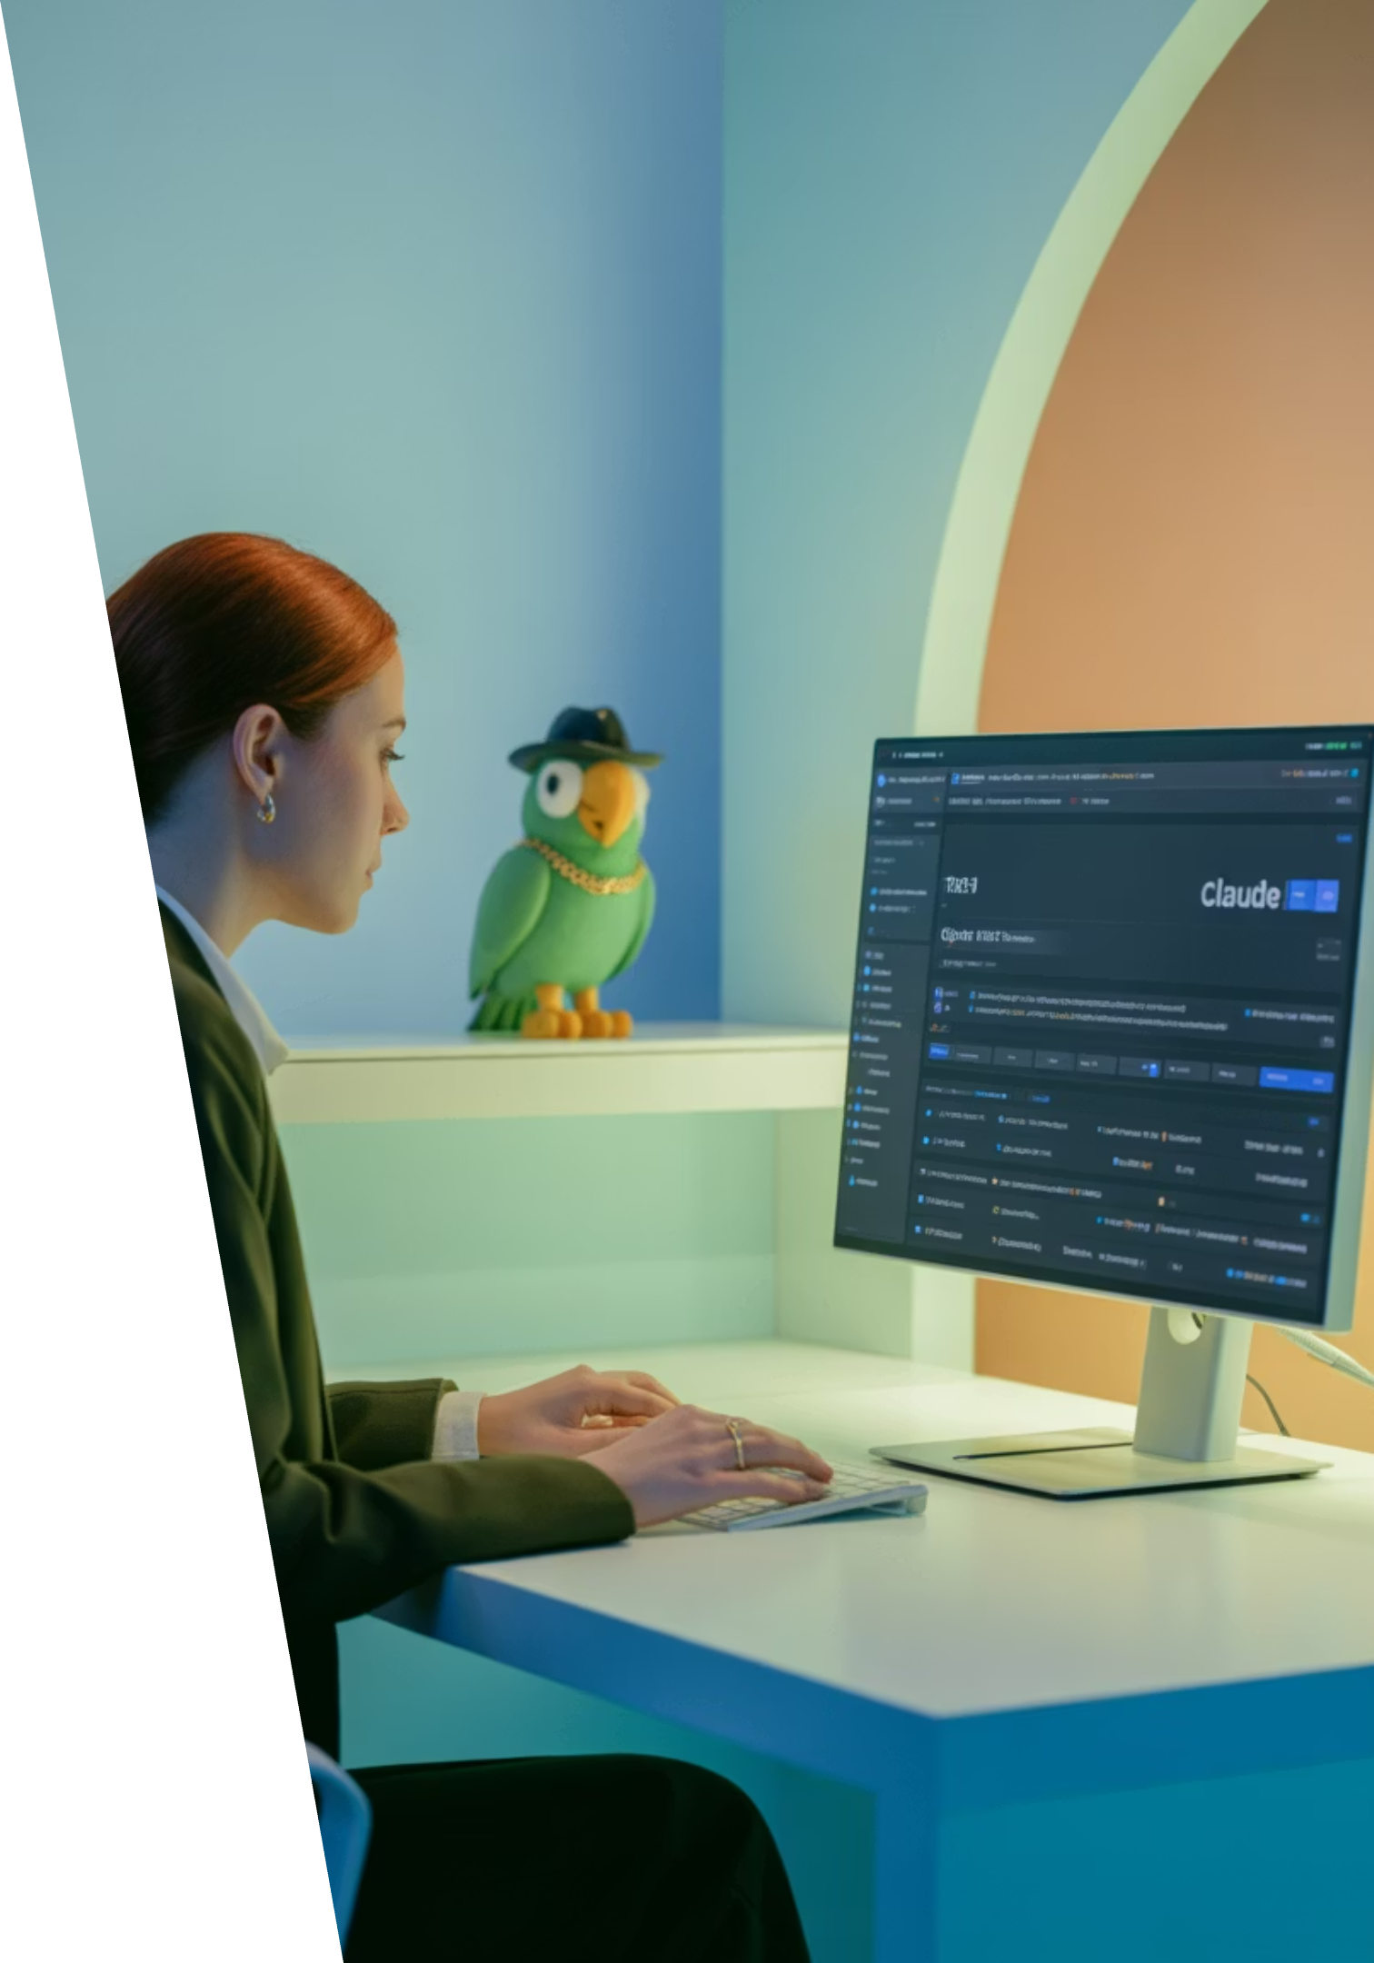
Showcase
Claude AI Agentic Development Workflow - Nate
Understanding Claude's Capabilities
Overview of Claude's unique strengths and how they compare to other AI assistants
Setting Up Development Environment
Tools, APIs, and configurations for optimal Claude integration
Building Agentic Workflows
How to design systems where Claude acts as an autonomous agent
Real-World Applications
Case studies and examples from Texas businesses leveraging Claude
Join us as Nate demonstrates how Claude AI can transform your development process with Texas-sized efficiency gains!

Slide 33
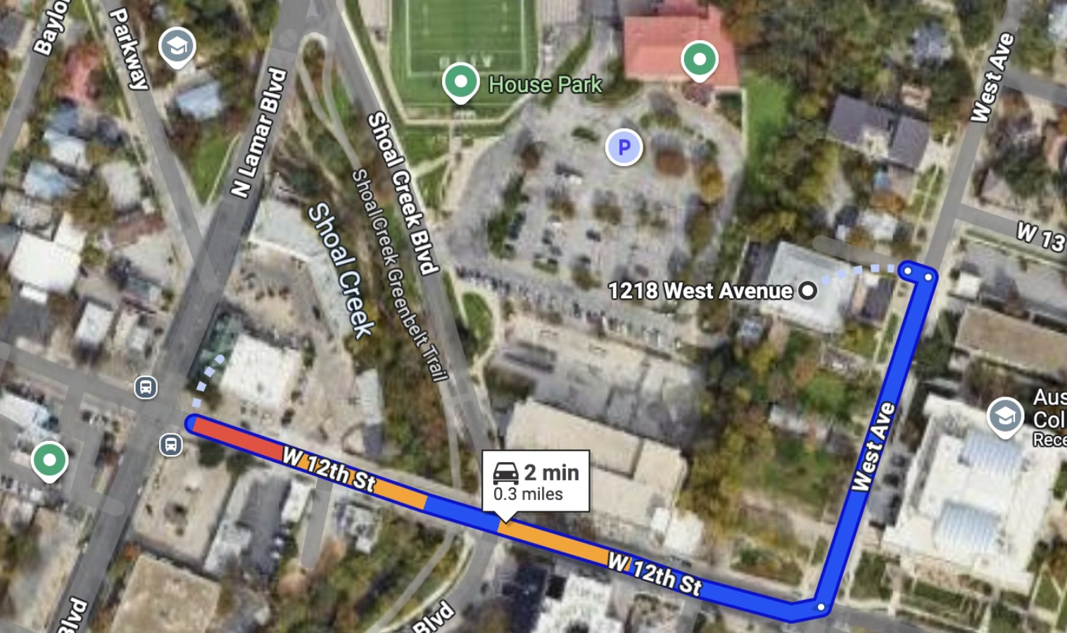





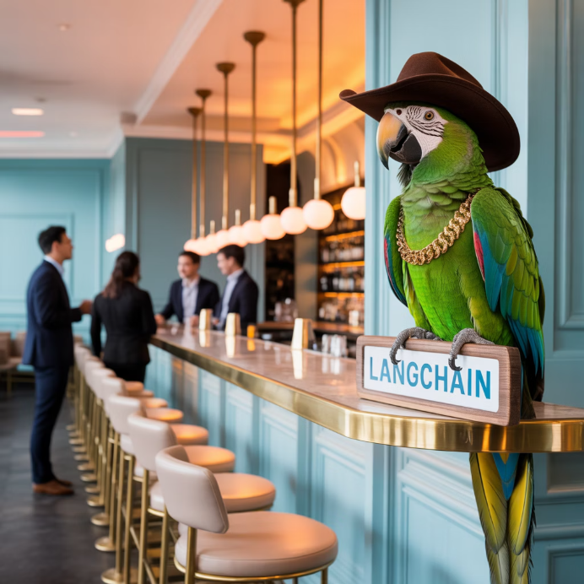

RGC-3000 and Tavern After Party
Join us after the meeting to continue conversations, network, and enjoy some Texas hospitality at The Tavern! Our green parrot mascot might even make an appearance.
Website
aimug.org – All things LangChain and AIMUG
Discord
Join us for ongoing conversations
GitHub
Austin LangChain Repo – Check out our projects
Meetup
Austin LangChain Group
ACC RGC3000 & The Tavern
Twitter
ACC Main Campus
@AustinLangChain – Latest updates
YouTube
Austin LangChain Channel

Slide 34
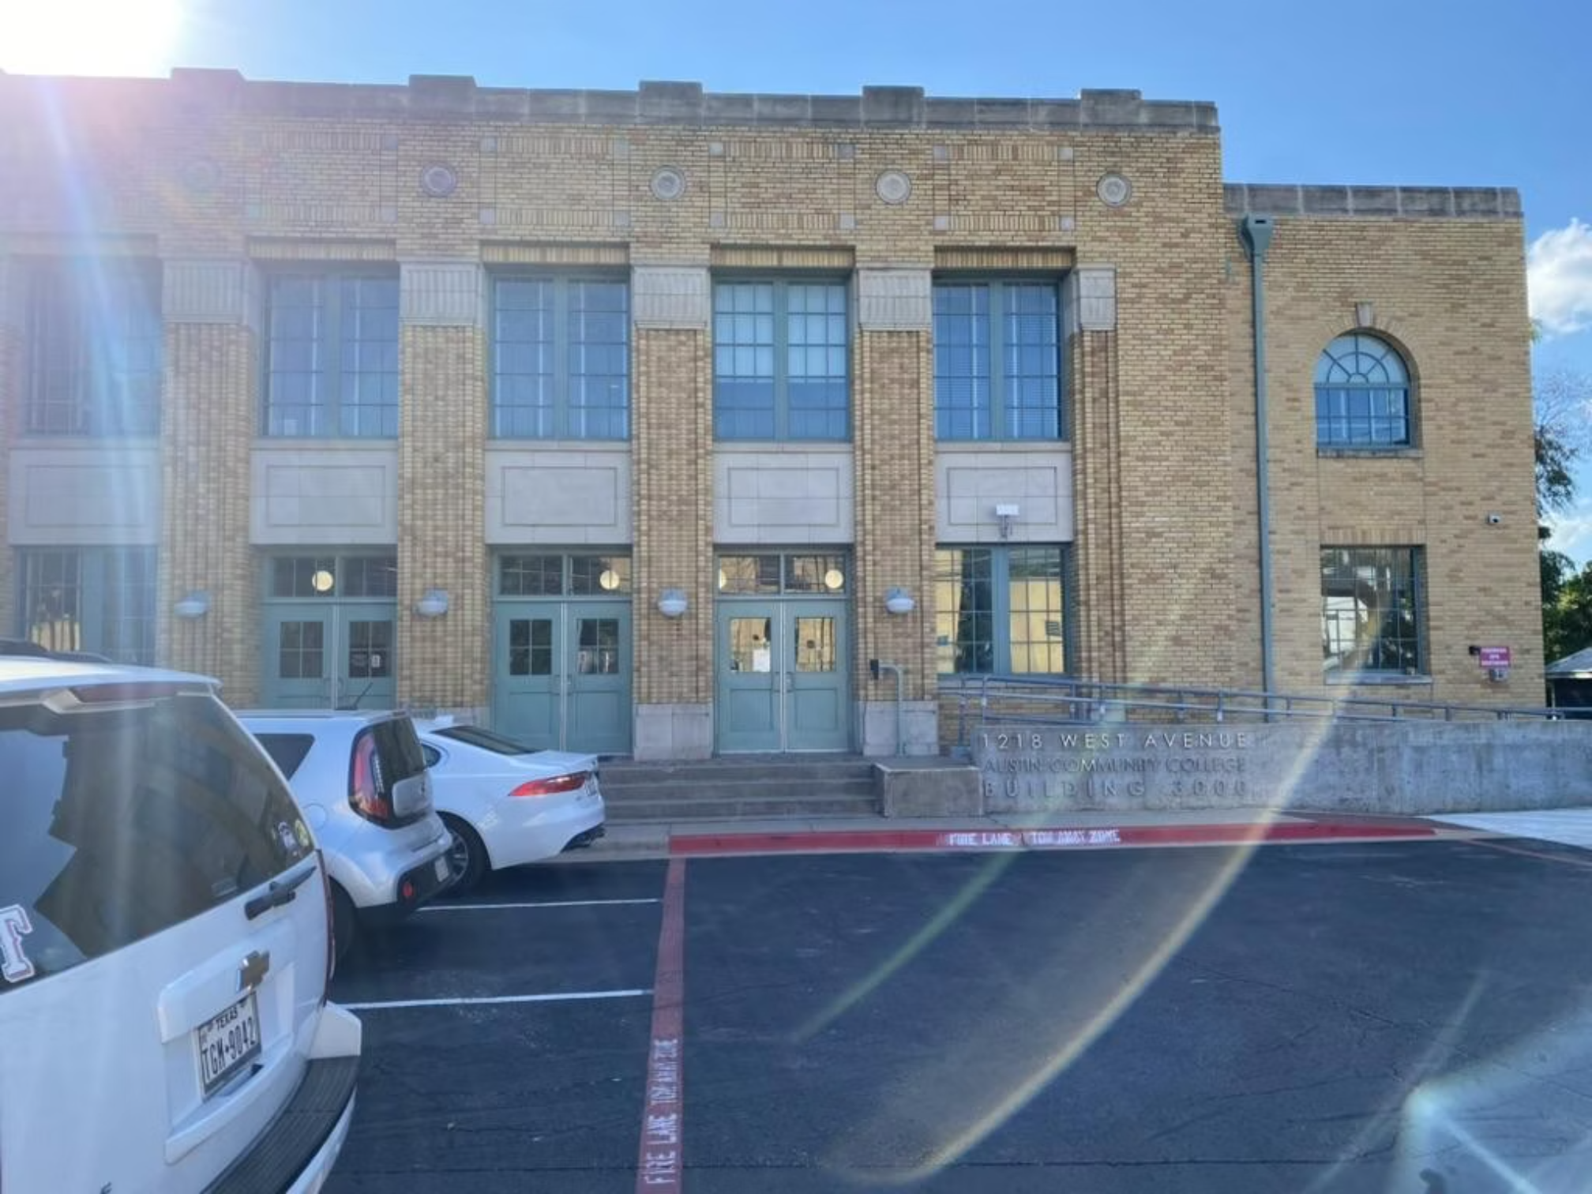
Finding US - ACC RGC-3000
The Austin Community College Rio Grande Campus (RGC) Building 3000 is our regular meeting location, offering modern facilities perfect for our tech-focused gatherings.
Easy Access
Centrally located in downtown Austin with parking available nearby
Tech-Ready Facilities
State-of-the-art presentation equipment and reliable Wi-Fi
Collaborative Spaces
Room arrangements perfect for both presentations and hands-on workshops
Look for Tex, our green parrot mascot with his cowboy hat and gold chain, greeting you at the entrance!

Slide 35
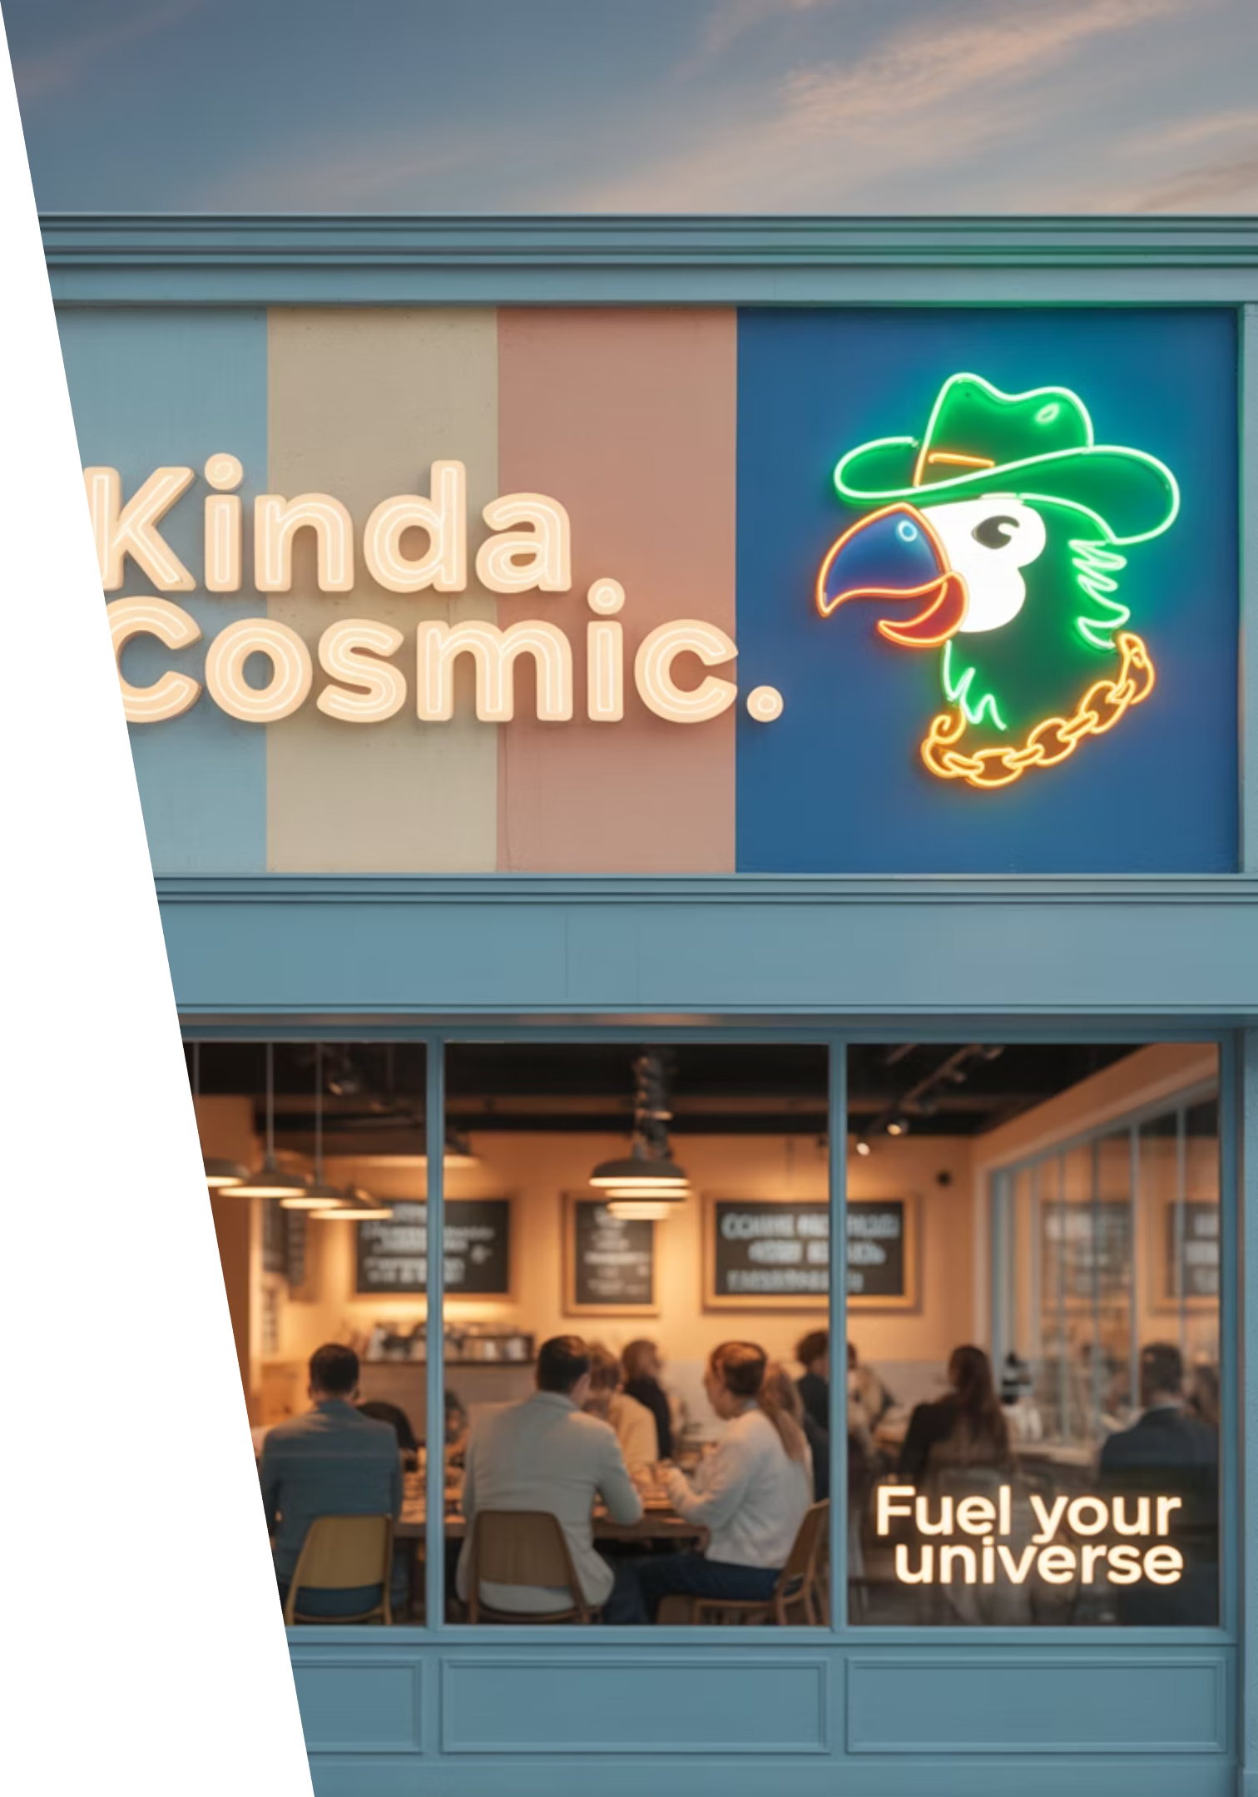






Next Event – Hacky Hour at Kinda Cosmic
Wednesday, August 27th
Casual Networking
Bring Your Projects
Join fellow AI enthusiasts for coffee, conversation, and coding in a relaxed Austin atmosphere
Get feedback, troubleshoot, or collaborate on your latest LangChain experiments
All Welcome
From beginners to experts, our community embraces diverse perspectives and experience levels
"Be cool to each other, don't be gross." Our only rule reflects our commitment to Texas hospitality in the tech world.
Keep an eye out for Tex, our green parrot mascot with his cowboy hat and gold chain – he'll be there too!

